Slide 1
The Physics of Project Management
While CPM Hasn’t Changed,
Everything Else Has.
How Three Decades of Tools Led Us to the Era of Adaptive, AI-Driven Planning
Dr. Dan Patterson, PMP
Pertmaster, Acumen, BASIS, PMFocus Founder

Slide 2
Four Eras of Scheduling
CPM-Native
Fundamental principles of planning
Risk-Adjusted
Covering the unknown
AI-Native
Context-awareness
Adaptive planning
Critiqued
Standard
tools
Moving the goalpost
Physics
Structural Integrity

Slide 3
Dan’s Philosophy About Project Overruns
Execution gets blamed, yet planning deserves It
  Late execution is simply a mis-perception
  A plan should be as reflective of reality as possible
  You can’t execute your way out of a plan that violates physics
  As such, it needs to adhere to standard laws and principles

Slide 4
The Laws of CPM Schedules
Law 1 - Variability Is a Given
Law 2 - Late Signals are Useless Signals
By the time variance appears at the outcome, it's already unrecoverable
Any plan that ignores variability will produce false certainty
Single point durations, one critical path, one finish date is a fake world
CPM schedules need to sense drift before it happens
Law 3 - Optimization of Specific Parts Degrades the Whole
Making one part of the plan better can make the overall outcome worse
Planning is a wicked problem, incremental gains is OK

Slide 5
Era # 1 – CPM Schedules

Slide 6
When was CPM invented?
Roman times
Late 1800’s
Before 2nd World War
After
1950

Slide 7
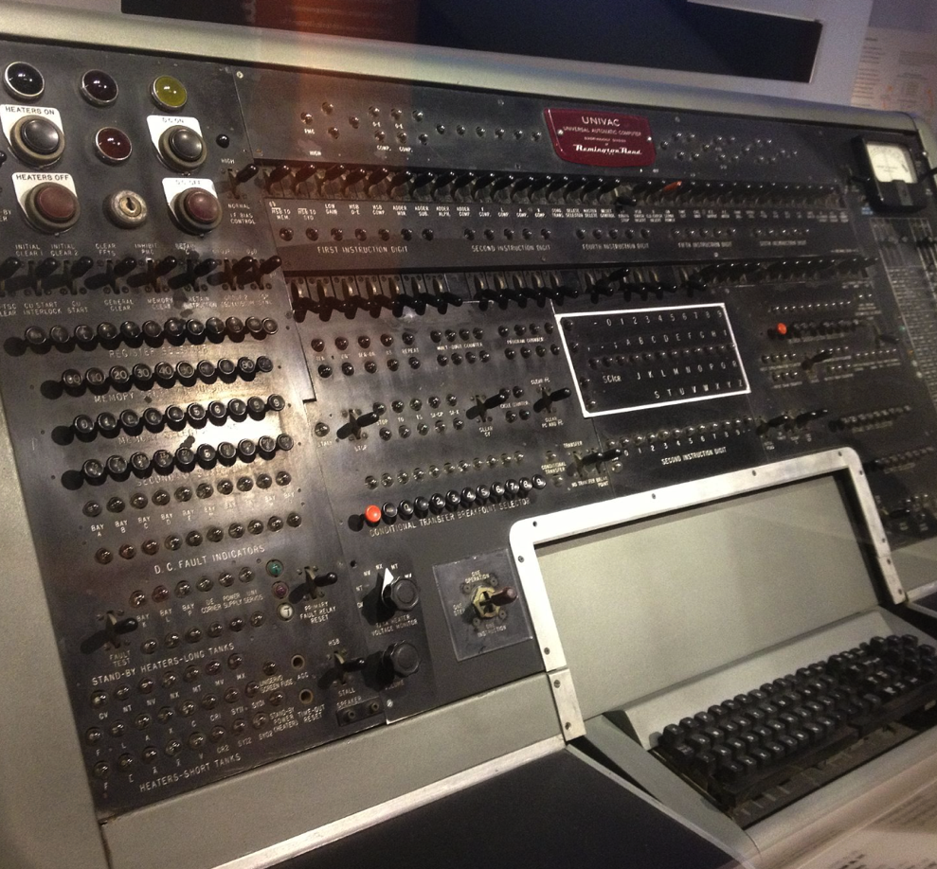
Era # 1 - Critical Path Method
CPM
CPM on the UNIVAC-1
1956 – CPM invented
  Dupont/Remington
  UNIVAC-1 computer
Calculation of dates & float
  Durations & logic are inputs
Today - same algorithm
  Forward, backward pass
  25 discrete lines of code

Slide 8
CPM Really Hasn’t Changed Much Since Then
Inputs
Outputs
Activity durations
Logic links
Calendars ☺ Constraints ☹
Resource leveling ☹
Target dates ☺
RDM, EV, GPM, Critical Chain
Early dates
Late dates
Float
Cost Integration
Required resources
Baseline compliance

Slide 9
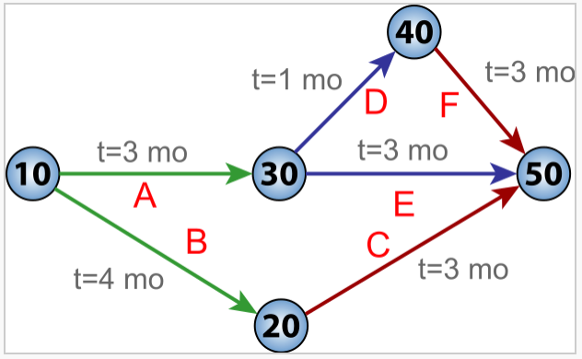
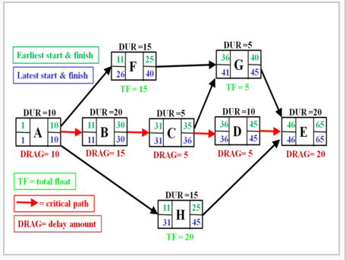
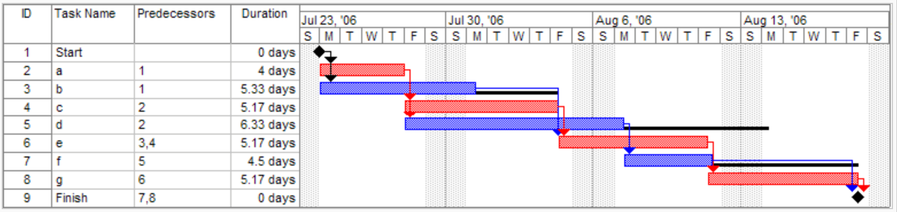
Not All Visualizations Stuck
Job on Arrow (ADM)
Job on Node (PDM)
Limited to single logic link
Unsung hero
Visual Overload
Hard to trace

Slide 10
1990’s to early 2000’s - What Was Available?
Tools
Impact
Primavera P3
  “It’s all about the logic…”
Welcom Open Plan
  Scheduling as a “discipline”
MS Project
  “Anyone can be a scheduler”
Artemis 9000
  Early enterprise planning
One plan – one outcome
  Lock the baseline & execute
No concept of uncertainty
  Deterministic planning
Limited team collaboration
  Terrible feedback loops
Rudimentary field execution
  Remember Webster, WelcomHome & WebProject?

Slide 11
I Was Fortunate Enough To Be a Part of Era #1
How It All Began For Me
It Sort of Didn’t Really Work…
PhD, UK research lab funded by Tarmac Construction
Developed a time chainage tool that had native CPM engine & AI knowledge library
“What if it doesn’t work…”
Extreme stroke of luck…
Houston is not near LA…

Slide 12
A Couple of Not So Tiny Thoughts
CPM Generates Best Case Scenario
We Wrongly Blamed Execution
Assumes everything will go as per the plan
  Doesn’t account for uncertainty
Not Goal-Based planning
  Why are we planning forward?
Plan the Work, then work the plan is a bit short sighted
  Planning shouldn’t be linear
  It should be iterative
Why did we think float is a good thing?
  Surely float means we planned poorly?

Slide 13
Is Float Really a Good Thing?
Float
Critical Path
Float
“float is the contractor’s friend, not the owner’s…”
CEO Kiewit

Slide 14
Era # 2 – Risk-Adjusted Schedules

Slide 15
Era #2 – Risk-Adjusted Scheduling
Assumes the plan needs more time
  Float absorbs risk
Risk-adjusted schedule
  Built-in contingency
Reveals hidden critical paths
  Path may actually jump
Risk impact versus score
  Top risks really worse?
Traditional CPM
Task A
6 days
Task B
4 days
= 10 days
Task C
8 days
= 8 days
2 days float
Risk-Adjusted CPM
Task A
6 days
2d U
Task B
4 days
5d
risk
= 17 days
3d float
Task C
8 days
6d uncert.
6d risk
= 20 days
Risk-adjusted plan is twice as long as CPM model & critical path is different

Slide 16
Monte Carlo Simulation Really Isn’t Complicated
The Inputs
The Analysis
Start with a CPM schedule
  Logic essentially stays the same
Model duration uncertainty
  Work becomes a range
Add in the extra bits
  Risk Events
  Probabilistic branches
  Weather windows
  Resource availability
Simulate execution
  Run 1000’s of iterations
Results normalize
  Form distributions
Sensitivity
  Reveals the drivers of risk

Slide 17
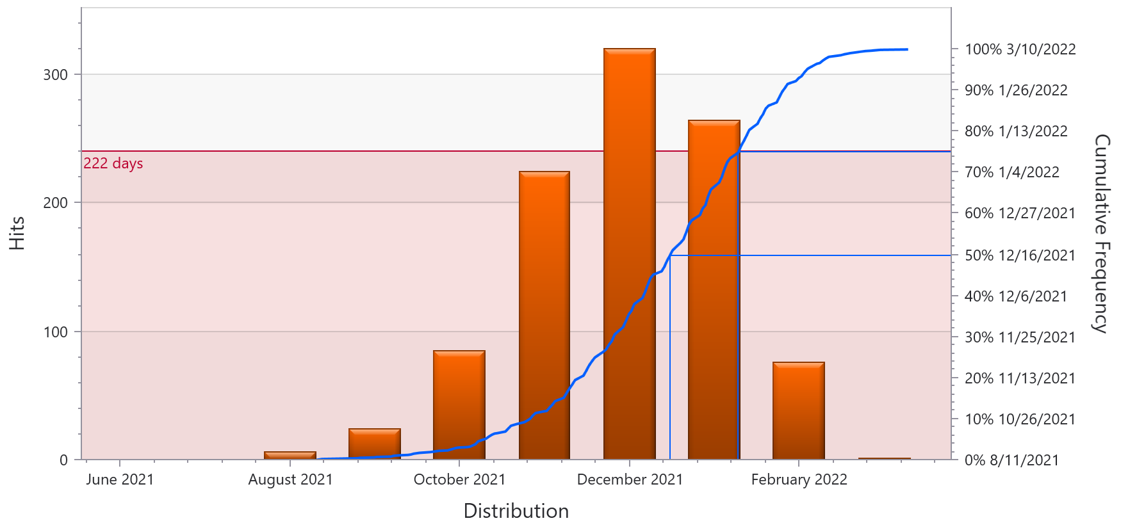
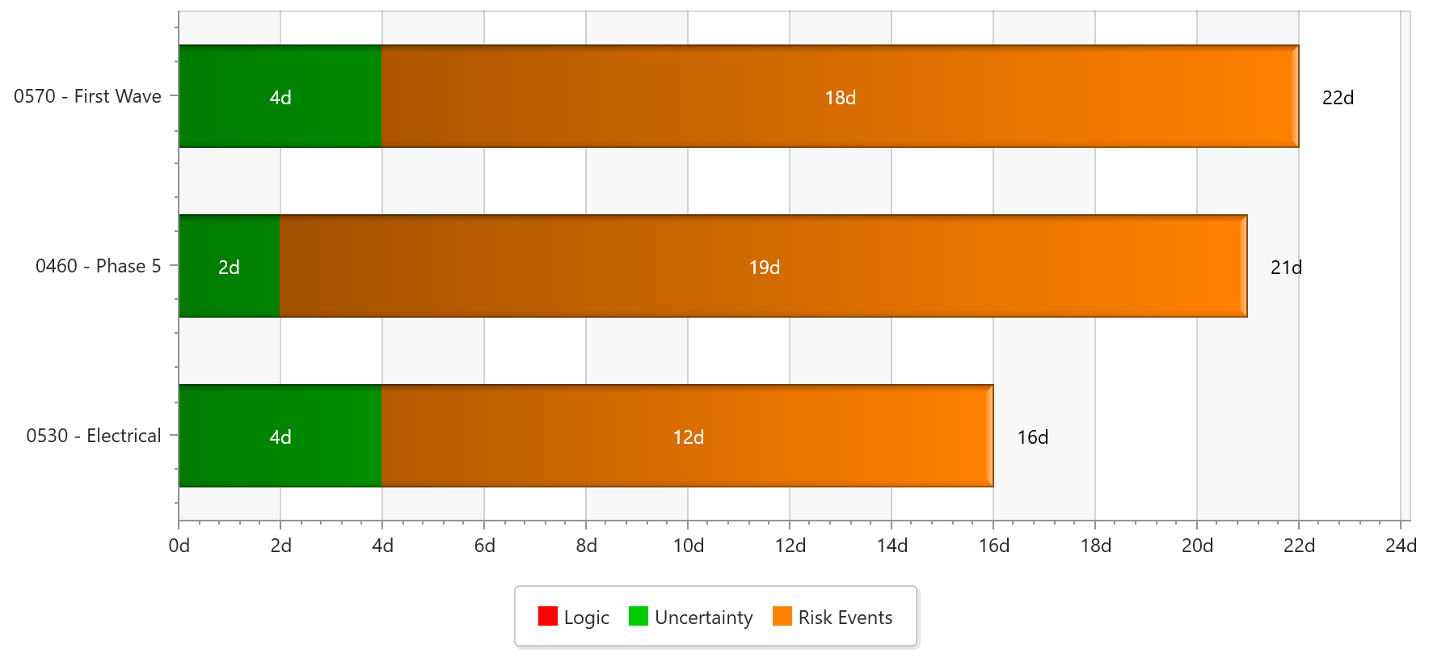
Reporting Risk Exposure
What is Our Risk Exposure?
Why Do we Have Exposure?
Scenarios e.g. P50, P75
Required contingency
Range is really the leading indicator
What is biggest contributor?
Risks or uncertainty root cause?
Multiple risks or pinpointed?

Slide 18
2000’s - What Was Available?
Tools
Impact
Primavera Monte Carlo
  Showed us uncertainty existed
@Risk
  Cost focus
RiskyProject
  Strong academic background
Pertmaster
  Fully-fledged risk-adjusted cost & schedule models
SafranRisk
  Strong risk register integration
Placed risk-adjusted scheduling on the map
  E.g. P75 plans
Triggered risk workshop concept
  Oil & gas embraced this
With power came misuse
  Models were highly prone to poor inputs

Slide 19
Again, I Was Fortunate Enough To Be a Part of this Era
The Trip to Best Buy
It Made a Difference!
We were self-funded
2005 Primavera Conference
You want us to pay for using the projector?
Forgiveness & redemption

Slide 20
A Couple of Not So Tiny Thoughts
The Model Inputs Were Ridiculous
Contingency is a Buffer Not a Fix
Trigen, uniform, triangular uncertainties
  What were we thinking ?
  No-one really understood what these meant
Risk registers
  Impact/probability scoring was super hard to get right
A P75 schedule assumes we are going to be late!
  The contingency hides the lateness
  Shouldn’t we look at compressing the schedule?

Slide 21
Era # 3 – Critiqued Schedules

Slide 22
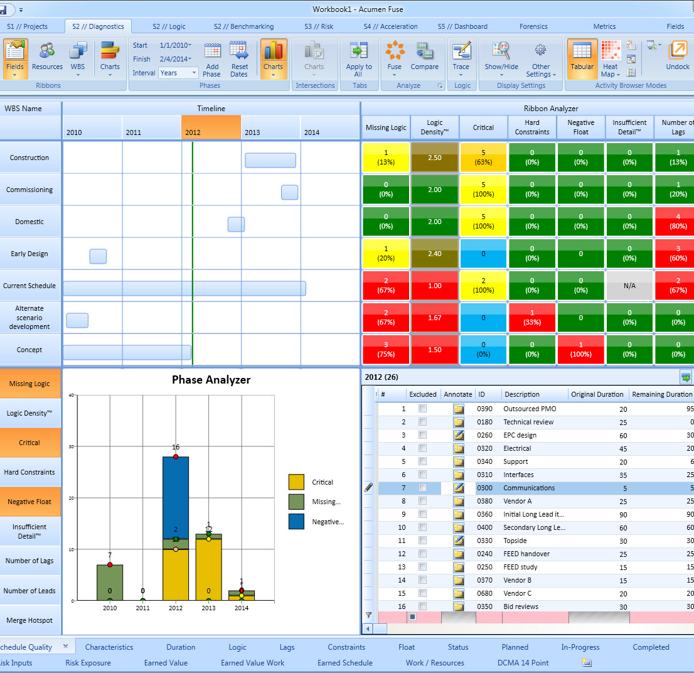
Era # 3 – Critiqued Schedules
We recognized that bad CPM structure produces bad outcomes
Test of logic, quality, realism & technical soundness
Retrospective analysis vs. true real-time guidance
Started with rudimentary counts

Slide 23
2010’s - What Was Available?
Tools
Impact
Primavera P6
  Literal counts of flaws
Ron Winter
  First to market
Pertmaster Schedule Checker
  Focus on risk
SteelRay
  Multi-platform deep dive
Acumen
  Took the science of schedule critique to the next level
DCMA 14 Point Check
  Standard checks
Schedule Index
  Overarching quality score
New era of metrics
  e.g. logic density
Drove quality of plans
  Structural integrity
Didn’t impact realism project
  Didn’t address incorrect logic
  Missed complexity e.g. site layout

Slide 24
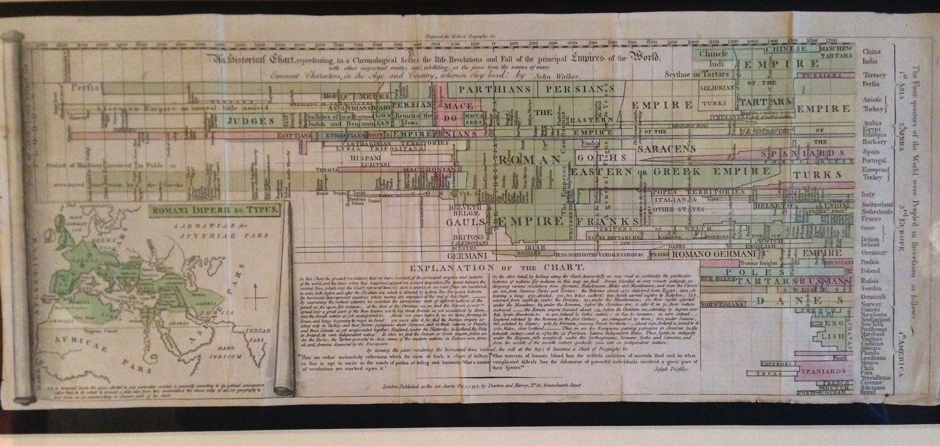
Again, I Was Fortunate Enough To Be a Part of this Era
The Trip to Edinburgh
It Also Really Worked!
Slice and dice to pinpoint weakness hotspots beyond simple counts was a groundbreaking concept, yet we couldn’t figure out the visualization

Slide 25
A 1795 Harmonogram (The Empire Chart)

Slide 26
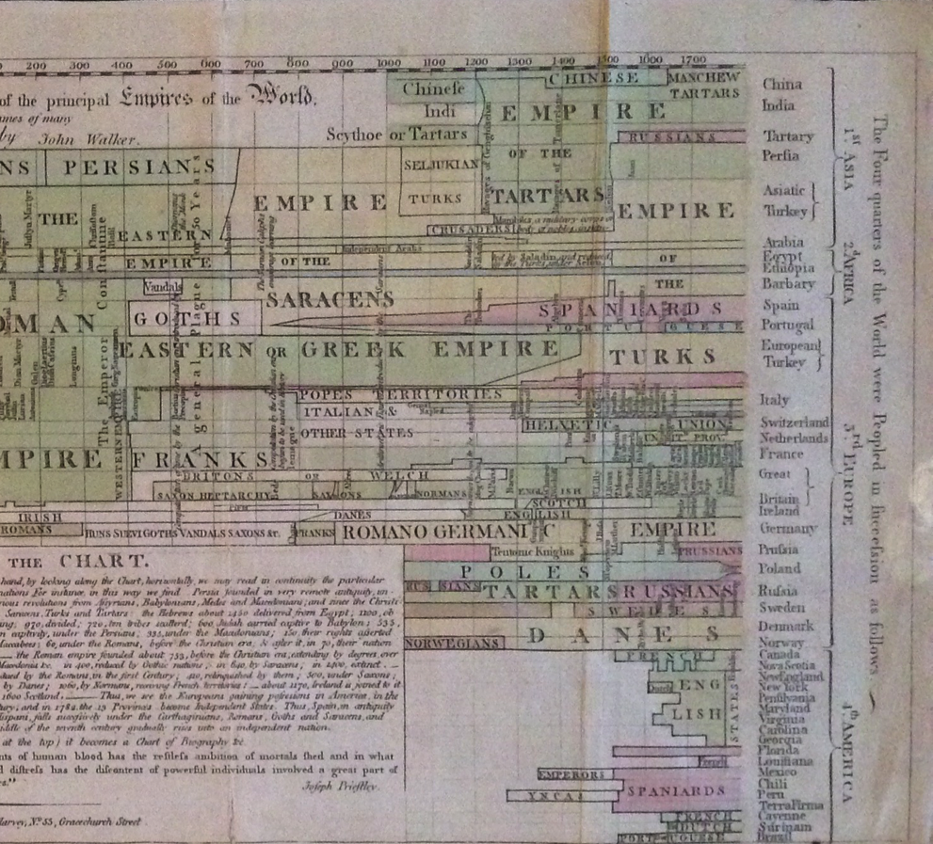
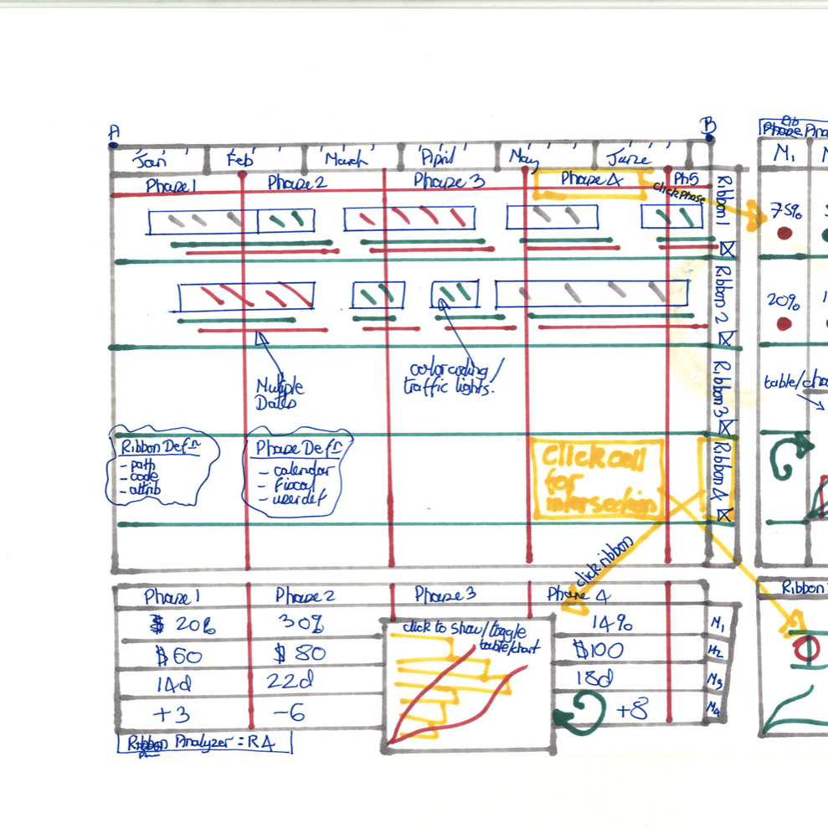
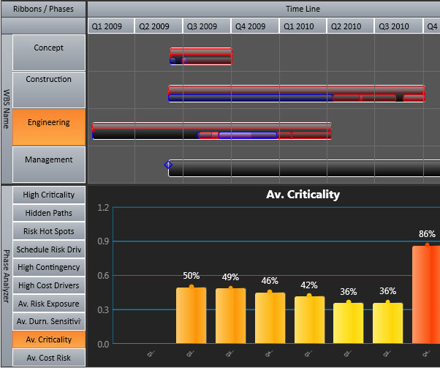
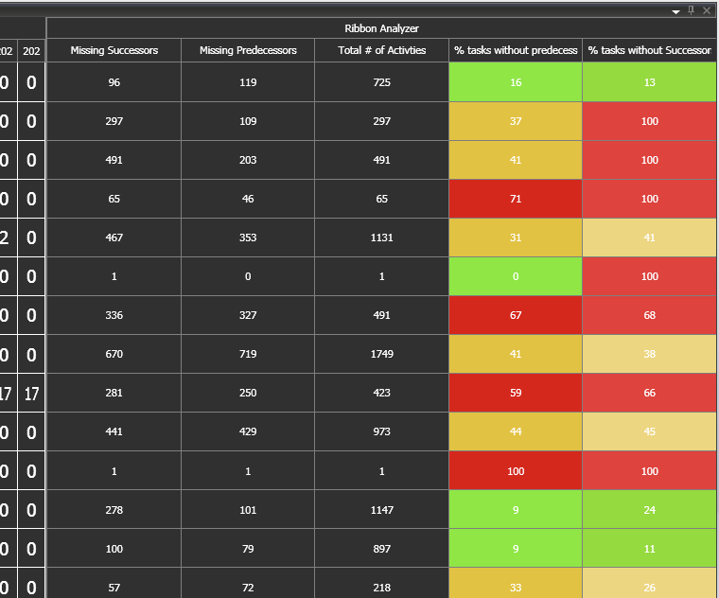
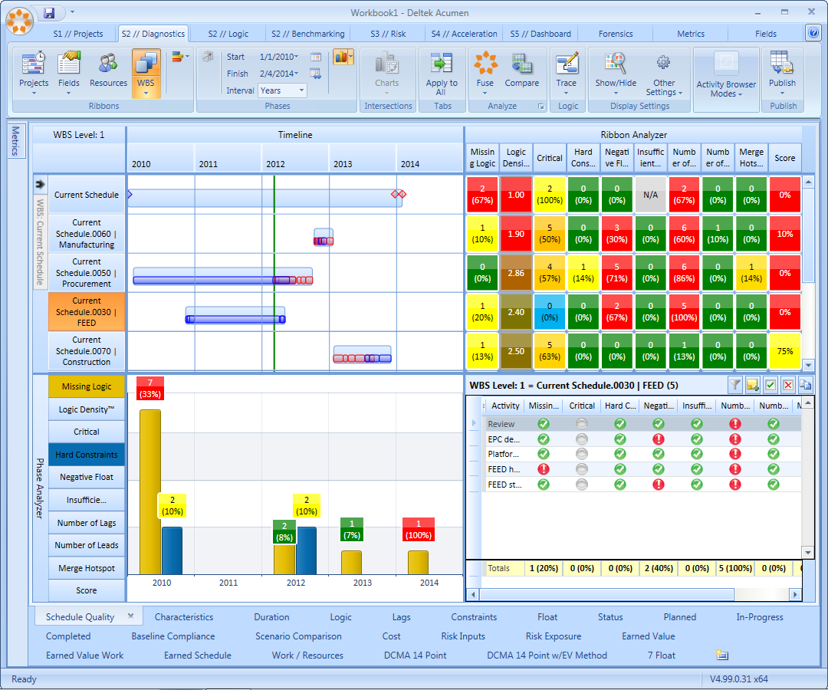
Standing on the Shoulders of Giants
1795 Harmonogram
2015 Harmonogram

Slide 27
Hard to Ignore the Impact of Schedule Quality
Schedule Index was a universal measure of schedule quality

Slide 28
A Couple of Not So Tiny Thoughts
Compliancy Doesn’t Mean Achievable
Metrics Don’t Tell us Anything
A schedule can be structurally sound yet still be unachievable
  Productivity/duration/sequence realism
Next-gen schedule critique
  Logic realism
  Site complexity
  Resource clashes
It’s the secondary double-click that tells us what we need to fix
  # of open ends doesn’t help
  It’s the impact of those open ends that is important
Critique is one thing, guidance is what is really needed…
  Tell me how to fix…
  Errors should never have been allowed in the first place

Slide 29
Era # 4 – AI-Native Schedules

Slide 30
Era # 4 – AI-Native Schedules
What Really is AI?
How Does AI Pertain to CPM?
Artificial Intelligence = Pattern Recognition at Scale
AI systems learn statistical patterns from large volumes of historical data
They do not “think” or “reason” like humans
They predict what is most likely given what has happened before
AI does not replace CPM — it learns from it
Instead of a single forecast, AI continuously evaluates schedule patterns, drift, and risk signals
Planning shifts from date commitment to outcome steering
The system updates as reality unfolds — not at the next reporting cycle
Decisions move from reactive to anticipatory

Slide 31
Types of Planning AI
Assistive | Agentic | Orchestrated | Autonomous
Helps me do my job better | AI can take actions on my behalf | Multiple AI agents work together across the system | “AI runs the planning system”
Human in the loop No real action | Doesn’t just advise Execute limited tasks | Multi-agent coordination | Self learning Humans set the goal, AI builds the plan
Schedule critique | Task re-sequence Logic repairs | Align cost, schedule, risk | Full plan development
“Copilot for planners” | “Junior Planner that never gets fired” | “AI as the planning system” | “Adaptive, self-steering planning”
LLM: Foundation Model + RAG

Slide 32
How Do we Train AI for CPM?
LLM layers
  Foundation Model: understands non structured data/language
    Akin to an undergrad generalist – very clever but not specific. ChatGPT, Gemini
  RAG: injects domain-specific knowledge
    Akin to a PhD specializing in CPM- your expertise and IP
The PMFocus AI Model
  Hundreds of historical CPM schedules
    Logic structures (FS, SS, lags, leads), critical path shifts over time, updates
  Risk registers (cause, probability, impact, mitigation)
    Outcomes (delay, cost growth, reforecast accuracy)
  What the Model Learns
    Which logic patterns consistently fail
    Which risks actually materialize (vs noise)
    Statistical fingerprints of overruns before they appear on the CP

Slide 33
Example ChatGPT Schedule Development
Assistive: Network quality
Structural Integrity: open starts/finishes, excessive constraints, lags, SS/FF misuse
Agentic: Constructability
Sequence critique: “should this really start before that’s complete?”
Duration realism: outliers, overly-long tasks, crew-logic mismatches
Orchestrated: Schedule Optimization
Sequence optimization: float-spreading & constructability
Risk adjustment: ranges and drivers
Automated: Full Schedule Generation
Based on scope, complexity, productivity
Autonomous Schedule
Fully context aware
Activity Critique: Float analysis, consistency of detail

Slide 34
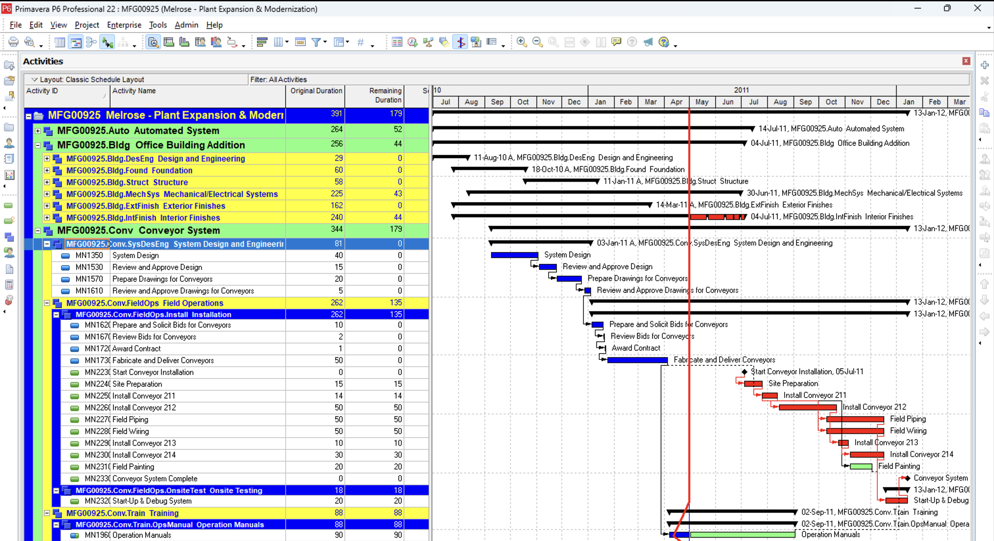
The Starting Point (RAG)
Example P6 schedule
+
500 prior EPC projects
Plans and outcomes
+
300 risk registers & models

Slide 35
Level 1 – Assistive Schedule Critique
Logic Fixes (Network Integrity)
Eliminate two open starts by tying Design Building Addition to Define System Requirements under a single Project Start.
Eliminate eight open ends by introducing a single Project Complete milestone.
Tie System Buyoff and Conveyor System Complete explicitly to Project Complete.
Remove negative lags (FS-10d) and replace with explicit overlap logic or design-maturity gates.
Replace “floating begin milestones” with real successors to avoid false schedule completion.
Ensure every finish milestone represents a physically complete deliverable, not a reporting artifact.
Similar insight to Era #2 tools
6/10

Slide 36
Level 2 – Agentic Constructability
Duration Changes (Forecast Quality)
Break Operation Manuals (90d) into draft, review, final, and turnover packages.
Split long field installation tasks (50d) into area- or system-based segments.
Decompose fabricate & deliver activities into release, fabrication, shipping, and receipt.
Reduce hidden float by shortening overly conservative durations created to mask uncertainty.
Align remaining durations with realistic weekly status cycles to improve early warning.
Analogous to my 30 years of EPC experience
8/10

Slide 37
Level 3 – Orchestrated Schedule Optimization
Risk analysis
Determine required contingency
Optimization - Sequence Changes (Constructability & Flow)
Remove large SS + 54–74 day lags that are masking missing scope and poor work packaging.
Introduce “Conveyor Install Ready” gate to correctly trigger piping and wiring
Ensure system installation logically precedes testing, buyoff, and production start.
Align building, MEP, and system work so parallelism reflects field reality, not paper concurrency.
Risk Analysis - Analogous to my 30 years of EPC experience
Optimization – way better than my 30 years of EPC experience
9/10

Slide 38
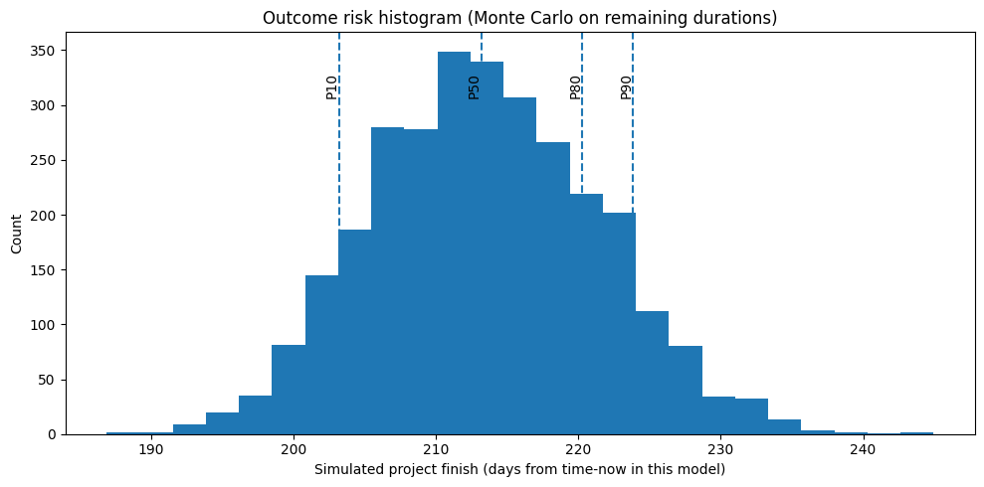
Orchestrated Risk Analysis

Slide 39
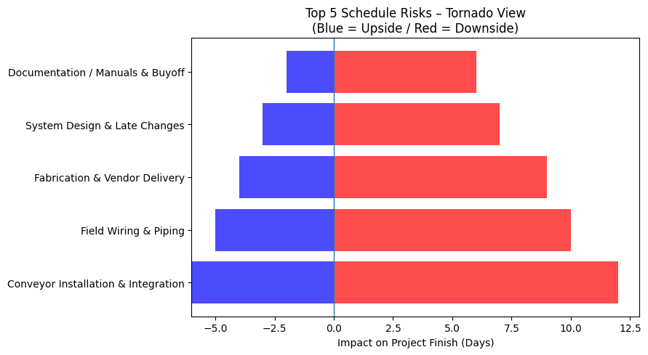
Key Risk Drivers

Slide 40
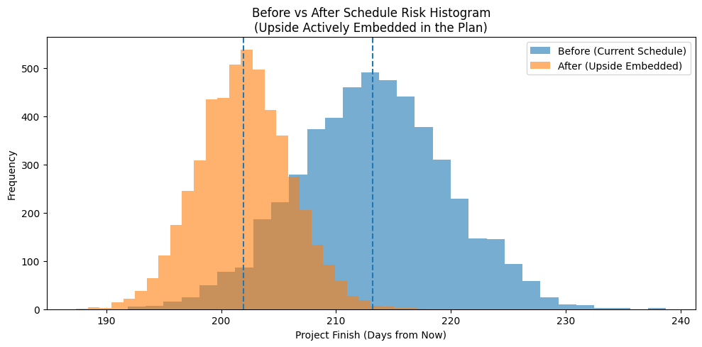
Impact on Schedule if we Address these Risks

Slide 41
From CPM to Orchestrated
Before
After
Multiple open starts and open ends → no single source of truth for start or finish
Finish dates driven by logic artifacts (lags, floating milestones), not targets
Negative lags and large SS + 50–70 day lags hiding missing scope
Long, monolithic activities (50–90 days) that cannot be reliably statused
Critical path shifts unpredictably with each update
Forecast confidence implied but not quantified
Management reacts after slippage becomes visible
Single Project Start and Project Complete anchor the network
All work logically connected — no open ends, no orphan milestones
Large lag-driven logic replaced with clear physical sequencing
Long activities decomposed into weekly statusable units
Stable critical and near-critical paths that persist across updates
Forecast expressed as probability ranges (P50 / P80 / P90)
Management intervenes early, based on risk signals not surprises

Slide 42
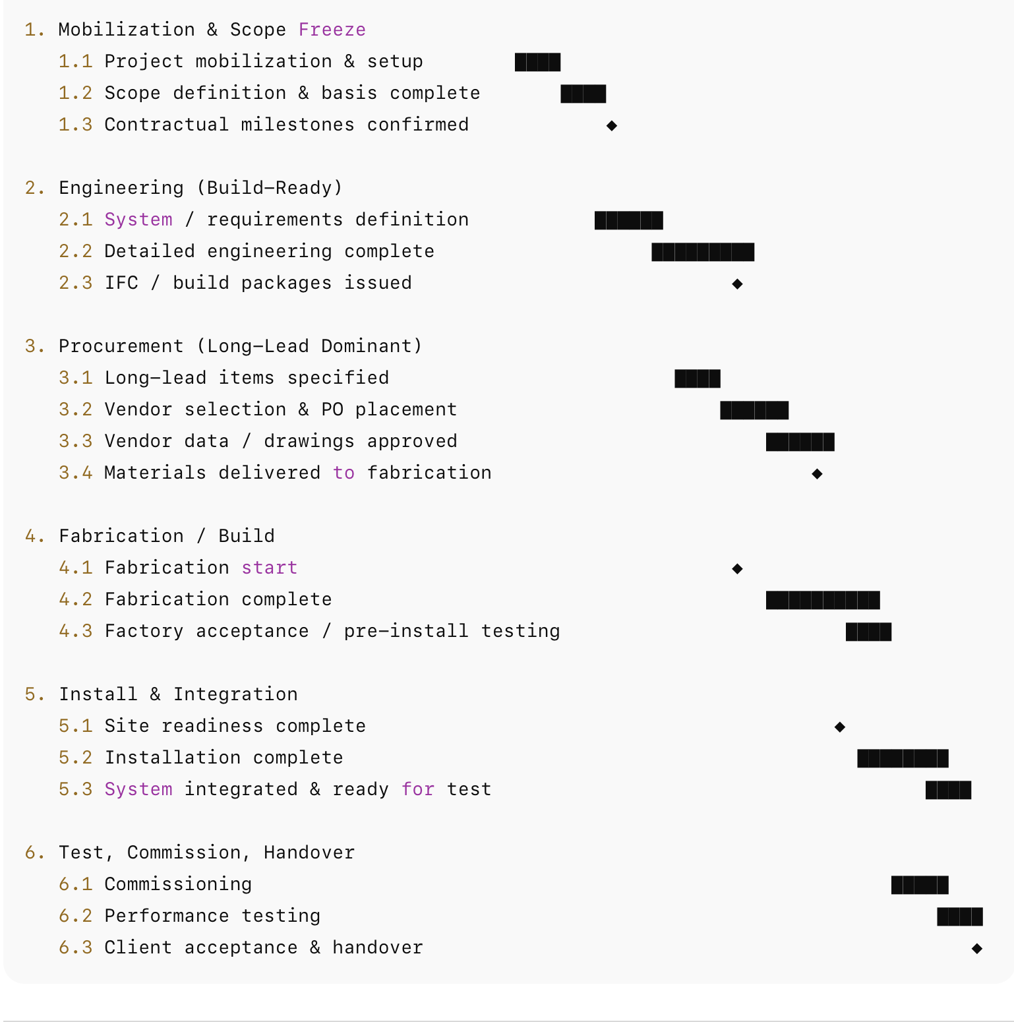
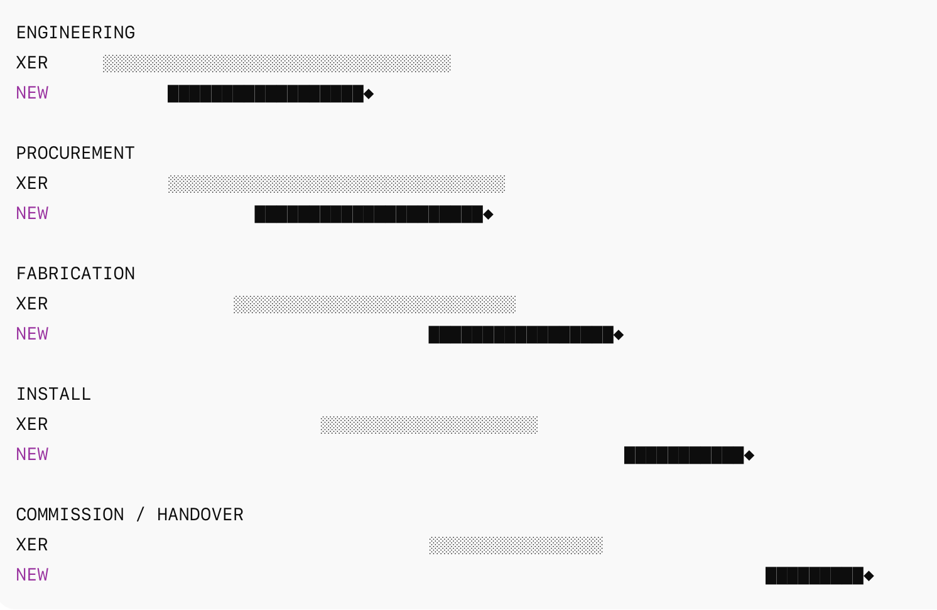
Level 4 - Automation – the Holy Grail
Automated Schedule Generation
Comparison to XER
The good: lower risk, shorter durations, later spread, less dense allocation of float
The bad: limited understanding of work parallelism
6/10

Slide 43
Net Net of Four Eras
What used to take me several days, took less than ten minutes to build using this custom GPT…

Slide 44
Conclusions
AI is Forcing a Change in Mindset
  For 30 years, we’ve been arguing about logic, float, and compliance
  AI lets us finally ask the question that really matters: ‘What usually happens next when schedules look like this?’”
Every schedule behaves like a physical system
  Logic defines flow
  Durations define required energy
  Lags, constraints, and long tasks create friction
  If the structure is weak, variability amplifies — no matter how good execution is
AI doesn’t yet 100% accurately predict the future
  It recognizes when a schedule is behaving like one that failed before
  Has the benefit of being highly adaptive in it’s predictions
  The expertise of the planner (human in the loop) is still very much a necessity

Slide 45
Thank You!

