Slide 1

2025 Construction CPM Conference Benchmarking As-Built Lags
Ron Winter, PSP, FAACE
Schedule Analyzer Software

Slide 2

Ron Winter, PSP, FAACE
Bachelor of Science in Engineering
Construction Scheduler
US Air Force Navigator
Construction Scheduler
Master of Science in Systems Management
Programmer, Project Manager, Customer Support, and Industrial Trainer
Construction Scheduler
Developer of Schedule Analyzer Software

Slide 3
What To Expect
Reporting relationship performance
The anatomy of a relationship
Relationship float consumption
Measuring relationship progress
Benchmarking relationship progress
Future of relationship tracking

Slide 4
2025 Construction CPM Conference Reporting Relationship Performance

Slide 5
Evolution of CPM Software
In the beginning there was ADM
Arrow Diagramming Method
ADM does not have relationships*
Relationships built-into activity IDs
Act 100-110 predecessor to Act 110-120
No need for a relationship report
Lags in PDM were just another ADM activity
Easy to benchmark ‘relationships’
Example, “Was concrete curing time observed?”

Slide 6
Evolution of CPM Software
Then came PDM
Precedence Diagramming Method
Logic represented by separate relationships
Planned versus actual lags difficult to see
Example, “Was concrete curing time sufficient?”
No relationship variance reports
Perhaps software companies ‘forgot’ to add this?

Slide 7
Obvious Missing Feature
Status of the remaining (in-progress) lag
We know this for activities
Why not for relationships?
Updating status of remaining lag
Huh? Who does that?
No one
Instead of SNET constraint on successor
Why not update lag?

Slide 8
2025 Construction CPM Conference Anatomy of a Relationship

Slide 9
Requirements to Begin
Completion of logical predecessors
Administrative requirements
Access to the work area
Enough qualified workers present
Supervision
Usable plans
Required materials and tools being present
Availability of required utilities

Slide 10
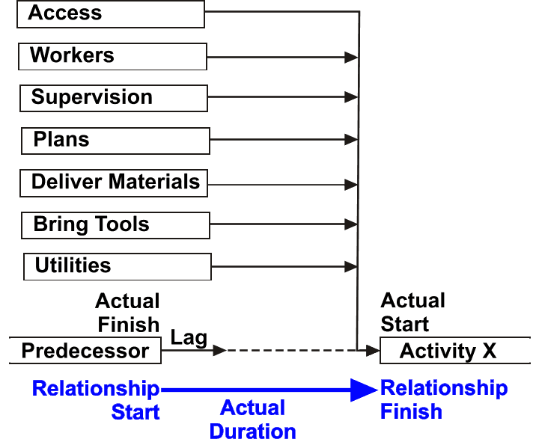
As-Built Relationship
Variance

Slide 11
Relationship Properties
You can’t manage what you can’t measure
With existing software
We can’t measure relationships
What is there to measure?

Slide 12
Rels & Activity Similarities
Both have duration
Relationship lag/activity remaining duration
May be expended non-linearly
Both have float
May be different
P6 shows relationship float on predecessor tab
Relationships do not consume resources
Except for time (and float)

Slide 13
2025 Construction CPM Conference Relationship Float Consumption

Slide 14
Rel Float Consumption
Relationship does not need to start on-time
If there is float available
Monitoring float consumption involves
Monitoring activity durations
Monitoring relationship durations
Relationship As-Built Report

Slide 15
Rel As-Built Report
----------Lag Duration---------- Lost
Pred C Float Succ C Float Type Planned Actual Remaing Variance Float
—————— - ——————— —————— - ——————— —— ——————— ——————— ——————— ——————— ———————
A1000 Y -76 A9050 N -19 FS 0 0 0 0 -57
A1000 Y -76 EW003 N 140 FS 0 163 0 163 -216
A1000 Y -76 A9630 N 144 FS 0 196 0 196 -220
A1000 Y -76 A8250 N 113 FS 0 0 0 0 -189
A1000 Y -76 A1200 N 83 FS 0 0 0 0 -159
A1000 Y -76 A1380 Y -54 FS 0 0 0 0 -22
A1000 Y -76 A1050 N 73 FS 0 0 0 0 -149
A1000 Y -76 A2460 N 82 FS 0 126 0 126 -158
A1000 Y -76 A7550 N 117 FS 0 84 0 84 -193
A1050 N 73 A1070 N 73 FS 0 0 0 0 0
A1070 N 73 A1080 N 73 FS 0 -1 0 -1 0
A1850 Y -54 A9830 Y -56 FS 0 19.6 0 19.6 2 *
A10930 N 2 A10950 N FS 0 13 0 13
… … …
—————— - ——————— —————— - ——————— —— ——————— ——————— ——————— ——————— ———————
425 total relationships with actual progress were analyzed.
CAUTION: Lines ending with a '*' indicate that the relationship was critical
and the lag delay caused it to lose (positive) float.

Slide 16
As-Built Float
Difficult to report
Once activity is complete
Float value not useful
Look-up activity float in baseline schedules
Critical relationship
Predecessor activity critical and
Successor activity critical
Alternatively; when relationship is critical
No one reports on this

Slide 17
2025 Construction CPM Conference Measuring Relationship Progress

Slide 18
Measuring Relationships
As-Planned versus As-Built lag durations
Can be benchmarked just like activities
Relationship Actual Duration Quality Statistics
Need to define what is ‘on-time’
The following examples use less that one day
(-0.9999 to +0.9999)
Four new reports

Slide 19
Summary Rel Analysis
All Relationships
Total relationships analyzed : 1484
Total relationships with actual progress : 425
Mean of the lag variance : 10
Standard Deviation of lag variance : 32.57
Number of early relationships : 22
Percent of early relationships : 5.18%
Number of on-time relationships : 236
Percent of on-time relationships : 55.53%
Number of late relationships : 167
Percent of late relationships : 39.29%
Just Critical Relationships
Total critical relationships : 53
Mean of critical lag variance : 1
Standard Deviation critical lag variance : 7.39
Number of early critical relationships : 6
Percent of early critical rels : 11.32%
Number of on-time critical relationships : 29
Percent of on-time critical rels : 54.72%
Number of late critical relationships : 18
Percent of late critical rels : 33.96%
Number critical lag delays with progress : 3

Slide 20
Lag Analysis
Does planned lag value affect accuracy?
Example
Planned Number Average Number Percent Number Percent Number Percent
Lag-Val of-Lags Actual On-Time On-Time Early Early Late Late
——————— ——————— ——————— ——————— ——————— ——————— ——————— ——————— ———————
0 725 31 115 15.86 149 20.55 461 63.59
1 32 21 0 0 1 3.12 31 96.88
2 3 9 0 0 0 0 3 100
5 8 3 2 25 4 50 2 25
10 1 2 0 0 1 100 0 0
65 1 65 1 100 0 0 0 0
——————— ——————— ——————— ——————— ——————— ——————— ——————— ——————— ———————

Slide 21
Responsibility Analysis
Breakdown by successor responsibility
Planned Number Average Number Percent Number Percent Number Percent
Act Code Lag-Val of-Lags Actual On-Time On-Time Early Early Late Late
—————————— ——————— ——————— ——————— ——————— ——————— ——————— ——————— ——————— ———————
Client 0 100 1 25 25 3 3 72 72
Contractor 0 325 34 66 20.31 48 14.77 211 64.92
Designer 0 217 20 64 29.49 8 3.69 145 66.82
Supplier 0 61 7 11 18.03 3 4.92 47 77.05
Contractor 1 1 4 0 0 0 0 1 100
Contractor 2 1 2 1 100 0 0 0 0
Designer 4 4 22 0 0 1 25 3 75
Contractor 4 3 3 0 0 1 33.33 2 66.67
Contractor 5 3 8 0 0 0 0 3 100
Contractor 8 5 52 0 0 1 20 4 80
Supplier 8 1 32 0 0 0 0 1 100
Contractor 11 1 88 0 0 0 0 1 100
Contractor 12 2 52 0 0 0 0 2 100
Supplier 15 1 28 0 0 0 0 1 100
Supplier 16 1 28 0 0 0 0 1 100
Contractor 22 1 20 0 0 1 100 0 0
Contractor 24 1 152 0 0 0 0 1 100
—————————— ——————— ——————— ——————— ——————— ——————— ——————— ——————— ——————— ———————

Slide 22
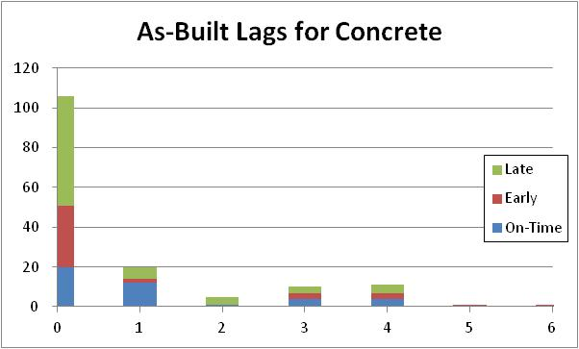
Lag Graphical Analysis

Slide 23
2025 Construction CPM Conference Benchmarking Relationship Progress

Slide 24
Benchmark Study
 |  |  |  | Early |  | On-Time |  | Late
Schedule Name | Started Rels | Ave Lag Variance | St. Dev Variance | Total | Percent | Total | Percent | Total | Percent
EKR2 | 41 | -2 | 12 | 24 | 59% | 12 | 29% | 5 | 12%
PL03 | 77 | -1 | 33 | 23 | 30% | 19 | 25% | 35 | 45%
HQNE | 146 | 0 | 13 | 54 | 37% | 29 | 20% | 63 | 43%
PARK | 152 | 2 | 8 | 15 | 10% | 51 | 34% | 86 | 57%
TR11 | 128 | 3 | 27 | 35 | 27% | 29 | 23% | 64 | 50%
SP10 | 78 | 5 | 13 | 6 | 8% | 17 | 22% | 55 | 71%
0009 | 216 | 8 | 16 | 15 | 7% | 46 | 21% | 155 | 72%
SA11 | 954 | 8 | 88 | 279 | 29% | 85 | 9% | 590 | 62%
UP12 | 638 | 9 | 42 | 71 | 11% | 187 | 29% | 380 | 60%
6800 | 425 | 10 | 33 | 22 | 5% | 236 | 56% | 167 | 39%
COUR | 6021 | 10 | 45 | 998 | 17% | 967 | 16% | 4056 | 67%
VOGL | 96 | 11 | 30 | 9 | 9% | 41 | 43% | 46 | 48%
CPWT | 1204 | 12 | 149 | 422 | 35% | 202 | 17% | 580 | 48%
POLB | 269 | 12 | 41 | 64 | 24% | 29 | 11% | 176 | 65%
OMVP | 643 | 13 | 89 | 195 | 30% | 32 | 5% | 416 | 65%
0755 | 1940 | 14 | 63 | 697 | 36% | 113 | 6% | 1130 | 58%
CHOP | 10808 | 14 | 68 | 2998 | 28% | 1841 | 17% | 5969 | 55%
MULE | 7244 | 14 | 36 | 740 | 10% | 2092 | 29% | 4412 | 61%
HQNG | 5311 | 16 | 37 | 394 | 7% | 1524 | 29% | 3393 | 64%
WTPR | 731 | 17 | 88 | 185 | 25% | 87 | 12% | 459 | 63%
7031 | 676 | 18 | 41 | 69 | 10% | 144 | 21% | 463 | 68%
JG09 | 526 | 19 | 38 | 95 | 38% | 42 | 8% | 389 | 74%
C001 | 92 | 20 | 26 | 11 | 12% | 17 | 18% | 64 | 70%

Slide 25
Benchmark Study
PS43 | 7644 | 21 | 91 | 2638 | 35% | 753 | 10% | 4253 | 56%
SHTE | 1161 | 21 | 41 | 145 | 12% | 222 | 19% | 794 | 68%
2W52 | 4672 | 23 | 107 | 1468 | 31% | 561 | 12% | 2643 | 57%
HYD4 | 728 | 23 | 54 | 66 | 9% | 167 | 23% | 495 | 68%
0575 | 203 | 28 | 72 | 16 | 8% | 82 | 40% | 105 | 52%
1134 | 5101 | 30 | 55 | 527 | 10% | 709 | 14% | 3865 | 76%
A031 | 770 | 31 | 97 | 155 | 20% | 118 | 15% | 497 | 65%
CU38 | 15234 | 31 | 61 | 2688 | 18% | 1883 | 12% | 10663 | 70%
HWY2 | 5915 | 32 | 73 | 840 | 14% | 1318 | 22% | 3757 | 64%
1501 | 7513 | 35 | 98 | 1020 | 14% | 1748 | 23% | 4745 | 63%
HQNS | 945 | 35 | 63 | 95 | 10% | 166 | 18% | 684 | 72%
3332 | 972 | 37 | 88 | 185 | 19% | 162 | 17% | 625 | 65%
2827 | 6133 | 42 | 128 | 1149 | 19% | 1043 | 17% | 3941 | 64%
X101 | 2943 | 44 | 94 | 390 | 13% | 380 | 13% | 2173 | 74%
VERY | 21270 | 45 | 97 | 2149 | 10% | 6087 | 29% | 13034 | 61%
S053 | 5066 | 47 | 83 | 192 | 4% | 2231 | 44% | 2643 | 52%
RT58 | 385 | 49 | 106 | 47 | 12% | 46 | 12% | 292 | 76%
B114 | 2147 | 52 | 192 | 334 | 16% | 522 | 24% | 1291 | 60%
X042 | 1641 | 52 | 161 | 208 | 13% | 321 | 20% | 1112 | 68%
BT29 | 1201 | 58 | 160 | 248 | 21% | 223 | 19% | 730 | 61%
0813 | 1185 | 61 | 213 | 376 | 32% | 131 | 11% | 678 | 57%
0354 | 14281 | 93 | 273 | 1339 | 9% | 3610 | 25% | 9332 | 65%
PLPB | 1522 | 95 | 202 | 314 | 21% | 70 | 5% | 1138 | 75%
Mean |  | 26 |  |  | 19% |  | 20% |  | 61%
St. Dev. |  | 22 |  |  | 12% |  | 11% |  | 12%
Totals: 46 | 147048 |  |  | 24010 |  | 30395 |  | 92643
Average
Early
On-Time
Late

Slide 26
Benchmarking Relationships
46 independent schedules analyzed
Mean lag variance: 26 days
Standard deviation: 22 days
Benchmark study of as-built relationships
Schedules with mean variance greater than 48 days are out of the normal
7 schedules failed this benchmark

Slide 27
Benchmarking Relationships
46 independent as-built schedules analyzed
19% of the relationships finished early
20% finished on-time
61% of them finished late
When just critical relationships considered
20% of the relationships finished early
22% finished on-time
58% of them finished late

Slide 28
Benchmarking Relationships
In general,
20% of the relationships finished early
20% finished on-time
60% of them finished late
Other statistics,
87% schedules used lags greater than zero
24% schedules used negative lags
Average longest lag was 86 days

Slide 29
Non-Zero Lag Accuracy
Planned non-zero lags require intention
How accurate were the estimates?
Planned negative lags
Average finished 4 days later than planned
Standard deviation of 18 days
Planned positive lags
Average finished 17 days later than planned
Standard deviation of 18 days

Slide 30
Scheduler’s Short-Cut
Plan FS/0 with intention of starting early
Simplifies As-Planned Schedule
Overcomes owner objections
Actual start less than 3 days early (1-2 days)
98% of schedules showed some instances
1 out of 46 did not have scheduler’s short-cut
2 schedules had 30% short-cuts
Average was 8% of all relationships

Slide 31
2025 Construction CPM Conference The Future of Relationship Tracking

Slide 32
RDCPM™ Certification
Relationship Diagramming Method
Report on merge bias ‘mini-milestones’
User-definable relationship codes
Text narratives for relationships
Select relationships by predecessor and/or successor codes
Expand the types of relationships
Treat lags like activity durations
Allow calendars and duration types to be assigned

Slide 33
RDCPM™ Certification
Automatic lag modifications based on productivity
Complex logic based on rule sets
Improved handling of out-of-sequence progress
Change FS to FF
Expand float measurement types
Multi-calendar float
Path free float

Slide 34
Future of Rel Tracking
Some vendors have earned partial RDCPM™ certification
Also needed
Add the display of remaining lag duration
Add the display of actual lag duration
Add lag As-Planned/As-Built variance
Sort relationship reports based on planned lag

Slide 35
2025 Construction CPM Conference Conclusions

Slide 36
Conclusions
Switch from ADM to PDM software
Overlooked reporting on relationships
Relationships have many unused properties
Only limited by software offerings
Consumption of relationship float
Analysis can lead to better project management

Slide 37
Conclusions
Benchmark relationship performance
Can be limited to just critical relationships
General benchmarking averages
20% finish early
20% finish on-time
60% finish late
Holds true with general population and critical

Slide 38
Conclusions
Benchmark in-general findings
Planned negative lags are better estimated
Planned positive lags planned better than 0 lags
Scheduler’s Shortcut is a real phenomenon
Approximately 8% of all FS/0 relationships
High of around 30%

Slide 39
Conclusions
Future of CPM
Enhanced reporting of relationship statistics
Remaining lag and actual lag needed now
Up to software companies to meet the need

Slide 40

2025 Construction CPM Conference
Questions?
Ron Winter, PSP, FAACE
Schedule Analyzer Software
ron@ronwinterconsulting.com

