Slide 1

2025 Construction CPM Conference Mastering Out-of-Sequence Progress
Ron Winter, PSP, FAACE
Schedule Analyzer Software

Slide 2

Ron Winter, PSP, FAACE
Bachelor of Science in Engineering
Construction Scheduler
US Air Force Navigator
Construction Scheduler
Master of Science in Systems Management
Programmer, Project Manager, Customer Support, and Industrial Trainer
Construction Scheduler
Developer of Schedule Analyzer Software

Slide 3
Definition
Out-of-Sequence Progress
When an activity actually begins before the existing logic and predecessor activity’s status allows
When actual dates occur prior to logically computed dates (actual start or actual finish)
Abbreviated here as, “OOS”

Slide 4
Introduction
Why is out-of-sequence important?
Review of major concepts (properties)
Present out-of-sequence benchmarks
Out-of-Sequence reporting options
Text reports
Graphical analysis technique
Out-of-sequence report for MS Project
Better than the one P6 currently has

Slide 5
2025 Construction CPM Conference Out-of-Sequence Importance

Slide 6
Why is OOS Important?
Was the project plan reasonable?
Is it logic driven?
Is the schedule being followed?
Time for a recovery plan?
Schedule may be show on-time
Can the schedule be used for analysis?
Does it properly predict project completion?
Can it be used for a TIA?

Slide 7
Account for Disruptions
OOS are ‘minor’ disruptions to a project
May appear to initially be insignificant
They are documented in schedule
Accumulated changes over time may be significant
Create Half-Step Schedule for all updates
Will display all out-of-sequence work
How severe is it out-of-sequence?
We need to understand OOS properties

Slide 8
2025 Construction CPM Conference Out-of-Sequence Properties

Slide 9
Direct vrs. Indirect OOS
Directly Out-of-Sequence
An activity that logically starts prior to immediate predecessor activity
Indirectly Out-of-Sequence
An activity that starts prior some logically distant activity
It may even logically start after immediate predecessor activity

Slide 10
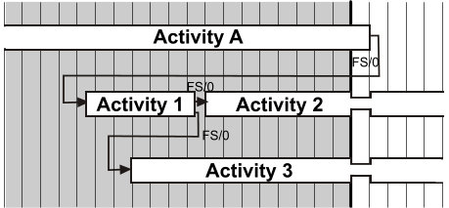
Direct vrs. Indirect OOS
Necking ‘proves’ out-of-sequence

Slide 11
Identifying Indirect
Follow successors from direct OOS act

Slide 12
Active vers. Inactive
Active Out-of-Sequence activities
Retained Logic delays re-start
Causes a ‘gap’ in barchart figures
Inactive Out-of-Sequence activities
Still out-of-sequence
Retained Logic no longer delays re-start
Due to predecessor activity being complete
Some CPM software do not report this

Slide 13
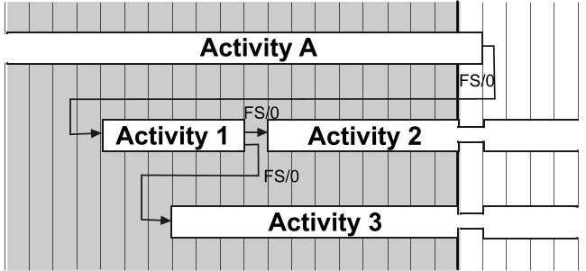
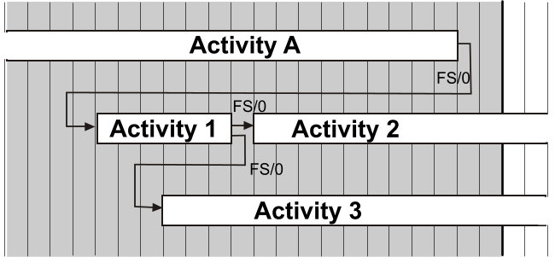
Active vers. Inactive

Slide 14
Types of OOS
Predecessor Complete | Predecessor Incomplete
Inactive / Direct | Active / Direct
Inactive / Indirect | Active / Indirect

Slide 15
OOS and Software
Reports Inactive & Active / Direct & Indirect
SA Forensic
Reports Inactive & Active Direct
Netpoint / Schedule Analyzer / Spider / Syncro / Open Plan / Power Project
Reports only Active Direct
P6 Professional
We can make P6 report Active Direct & Indirect
New P6 report filter

Slide 16
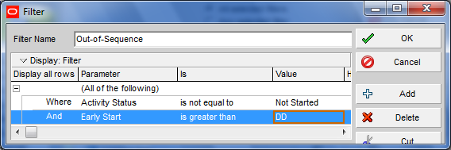
P6 Filter for All Active
Set a activity filter for
Activity has an Actual Start
Early Start date > Data Date
Both must be present

Slide 17
Events/OOS Activities
Every relationship executed out-of-sequence is an event
An out-of-sequence activity can have more than one out-of-sequence predecessor
More than one event
An activity with multiple events is more severely out-of-sequence than just one

Slide 18
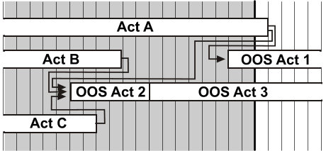
Events vrs. Activities
OOS Act 1 started early to one activity
OOS Act 2 started early on three activities

Slide 19
Degree of Early Start
The number of days started early matters
Maybe starting slightly early does not matter
Common construction practice to begin follow-on work a day or two early
Calling this FS/0 is a “scheduler’s short cut”
Starting weeks/months early is more severe
Finishing the out-of-sequence activity is more severe as well

Slide 20
Properties Summary
Direct versus Indirect OOS
Current versus historic out-of-sequence
Active versus Inactive OOS
Tracking OOS logic events vers. activities
Degree (duration) of the early start

Slide 21
2025 Construction CPM Conference Benchmarking Out-of-Sequence

Slide 22
Statistical Findings
Analyzed 46 independent construction schedules
All four types identified
 | Started Acts | Ave Early (WD) | Direct Events | Direct Acts | Indirect Events | Indirect Acts | Total Events | OOS Acts | % Acts OOS | Events /OOS
Average | 1661 | 54 | 1089 | 489 | 266 | 79 | 1342 | 568 | 40% | 1.65
Median | 734 | 47 | 296 | 227 | 104 | 32 | 360 | 250 | 38% | 1.52
St. Dev. | 2476 | 39 | 2188 | 805 | 506 | 182 | 2502 | 875 | 18% | 1.01

Slide 23
Early Starts
OOS early starts greater than one standard deviation:
Mean (average): 45 work days
Standard Deviation: 48
Failure (more than one standard deviation)
Average overlap greater than 45 + 48 = 93 work days

Slide 24
Percent of OOS
Percent of OOS activities greater than one standard deviation:
Mean: 40%
Standard Deviation: 18%
Failure (more than one standard deviation)
Average percentage greater than 40 + 18 = 58%

Slide 25
Benchmark Results
Of the 46 schedules evaluated
Ten exceeded mean of early starts
Six exceeded the mean percentage of OOS
One schedule exceeded both benchmarks

Slide 26
2025 Construction CPM Conference Industry Out-of-Sequence Reports

Slide 27
Types of Reports
When report lists OOS relationships
Allows for event statistics
Netpoint / Schedule Analyzer / Spider / Syncro
When the OOS report only lists the activity
Cannot count events
Open Plan / P6 / Power Project

Slide 28
What Could be Reported
Out-of-sequence & predecessor activities
Total float
Applicable Dates
Relationship type and lag
Work and calendar days early start
Reason activity was out-of-sequence
OOS Pred Float Date Description
——————————————— ——————————————— ————— ———————————————— ————————————————————————————————————
575.CMOB.LA.100 519 S=01AUG13-00:00A LA - CONSTRUCTION MOBILIZATION - 33%
575.PM.120 0 F=28AUG13-08:00A FULL NOTICE TO PROCEED
——————————————— ——————————————— ————— ———————————————— ————————————————————————————————————
Rel/Lag=FS/0, WorkDays-Early=27.00, CalendarDays-Early=27.00
Problem: Activity started, predecessor has not finished.

Slide 29
Possible Statistics
————————————————————————————
RELATIONSHIP OUT-OF-SEQUENCE
SCHEDULE QUALITY STATISTICS
————————————————————————————
Total Number of Started Activities with Predecessors: 12295
Direct Out-of-Sequence Activities : 3021
Indirect Out-of-Sequence Activities : 239
Total Number of Out-of-Sequence Activities : 3260
Both Direct and Indirect Activity (not counted) : 547
Percentage of Out-of-Sequence Acts : 26.51%
Total Direct Out-of-Sequence Events : 4271
Total Indirect Out-of-Sequence Events : 1130
Number of Active Direct OOS Activities : 623
Number of Active Indirect OOS Activities : 239
Total Number of Active OOS Activities : 862
Average Length of Early Starts: 82.21 days
Summary of Direct Out-of-Sequence Totals for Reason Types:
3209 Activities started, predecessor has not finished.
7 Activities started before its predecessor's lag would allow.
136 Activities started, predecessor has not started.
310 Activities finished, predecessor not started.
573 Activities started too early to allow it to finish on time.
36 Activities with lag started too early to allow it to finish on time.
Additional Reasons:
2003 Activities finished, predecessor has not finished.
19 Activities finished before its predecessor's lag would allow.

Slide 30
Graphical Analysis
Daily work profile
Percent of out-of-sequence
Events versus Activities
Profile without holidays
Target only early starts
Early start histogram

Slide 31
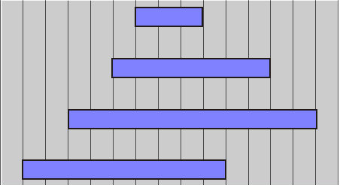
Calculate Work Profile
Plot the start/finish of each OOS activity
Add up each daily total

Slide 32
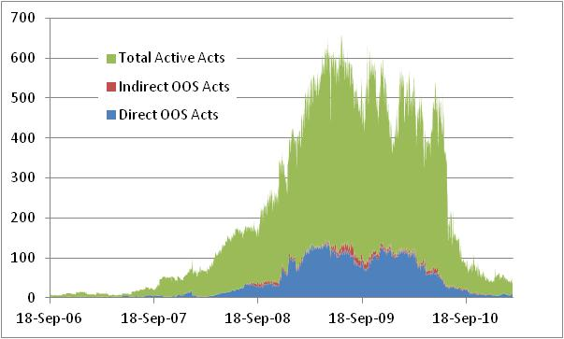
Typical Graph
How closely did OOS parallel total work?

Slide 33
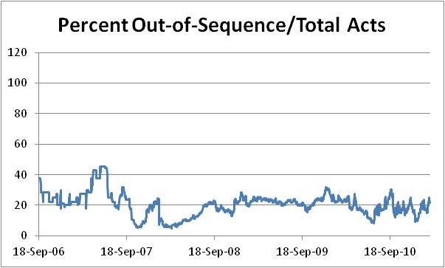
Track % of OOS
Start of major work
Once work really started it held steady at 20%

Slide 34
Events vers. Activities
Daily totals of OOS activities
Total OOS Events
OOS Activities

Slide 35
Profile No Holidays
Best Used Over Short Periods

Slide 36
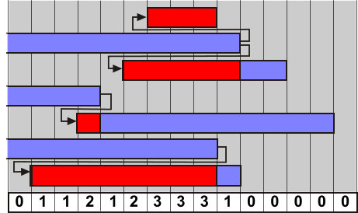
Target Early Starts
Ignore part of OOS not out-of-sequence
Identify the portion that is truly OOS

Slide 37
Example Early Starts
Events Before
Events After
OOS Before
OOS After

Slide 38
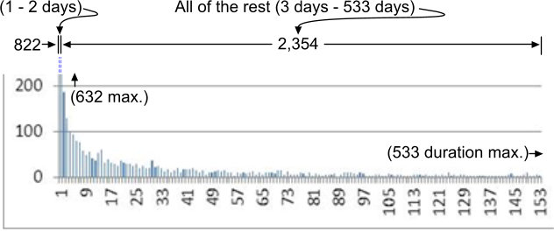
Early Start Histogram

Slide 39
2025 Construction CPM Conference Program Project for Out-of-Sequence

Slide 40
Project OOS Reporting
Not a ‘built-in’ Microsoft Project feature
Report added using Visual Basic (VBA)
Can be permanently used on all schedules
Given here as free open-source program
Works on all versions of MS Project

Slide 41
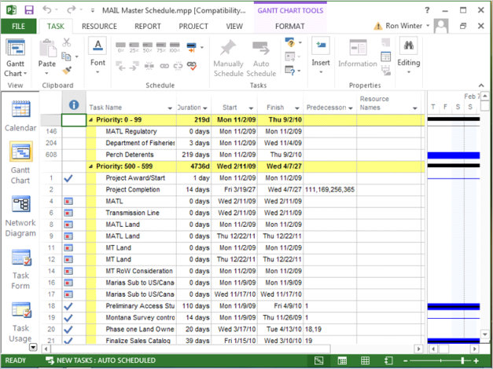
Creating OOS Report
Tabs
Ribbon Bar
Add the Developer Tab
Right-Click Ribbon Bar

Slide 42
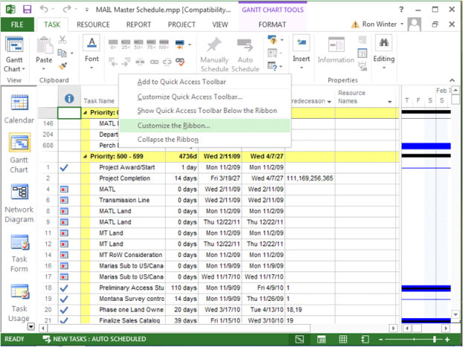
Creating OOS Report
Click on Customize the Ribbon

Slide 43
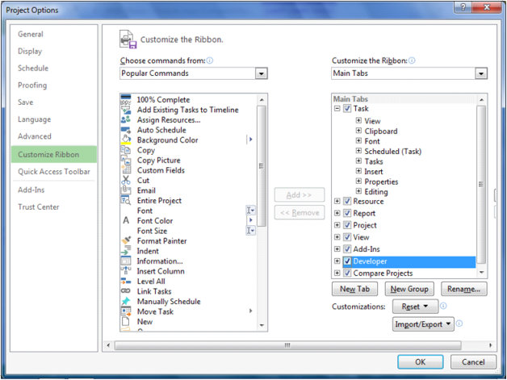
Creating OOS Report
Click on Developer checkbox
Click on OK button

Slide 44
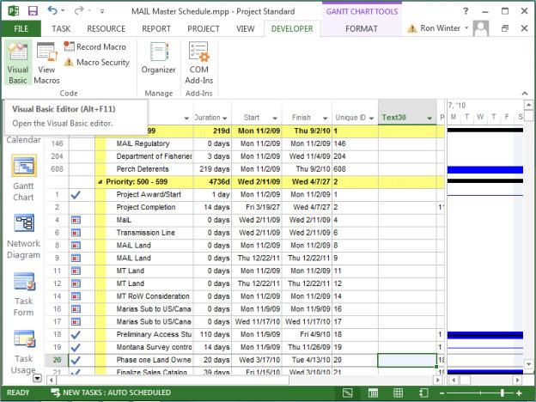
Creating OOS Report
Click on Developer tab
Click on Visual Basic button

Slide 45
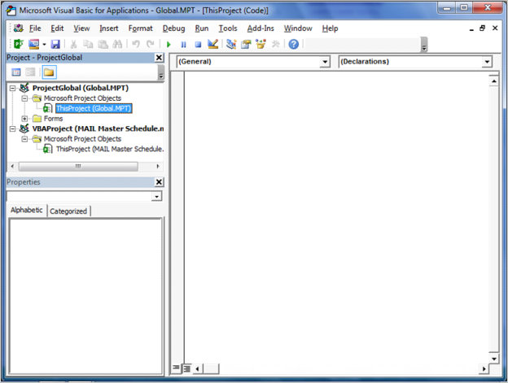
Creating OOS Report
Expand ProjectGlobal
Expand Project Objects
Double-click on ThisProject
Maximize Programming Window Area

Slide 46
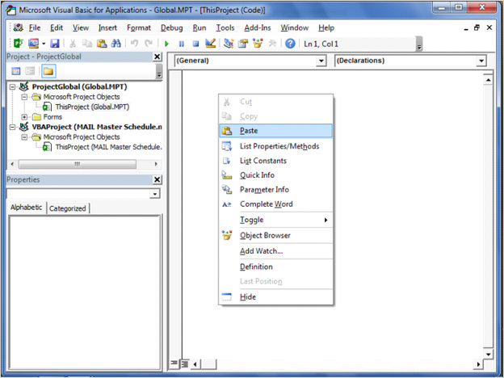
Creating OOS Report
Copy VB code
Paper
File
Right-click program window
Paste

Slide 47
Download VBA Program
ScheduleAnalyzer.com/eforensic_OOS_Survey.htm

Slide 48
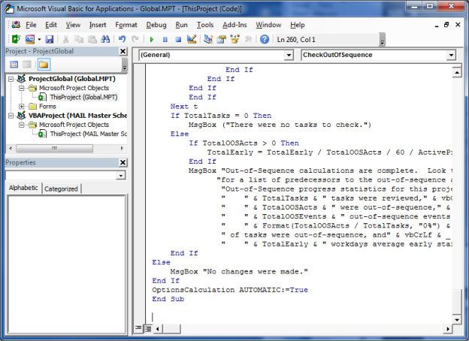
Creating OOS Report
End of program shown here

Slide 49
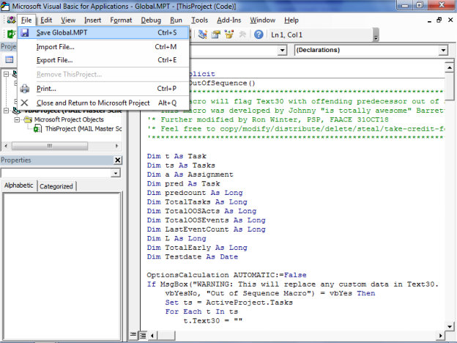
Creating OOS Report
Save program
File/Save
Close
File/Close
Returns to MS Project

Slide 50
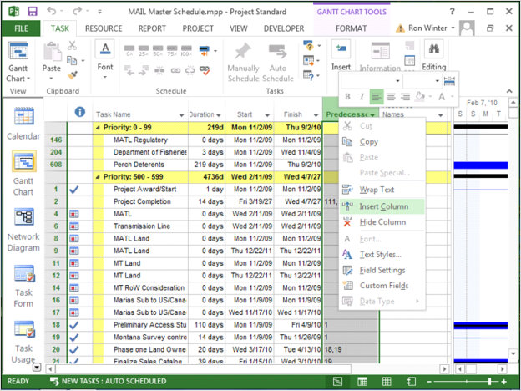
Creating OOS Report
Set-up display
Right-click column header
Click on Insert Column

Slide 51
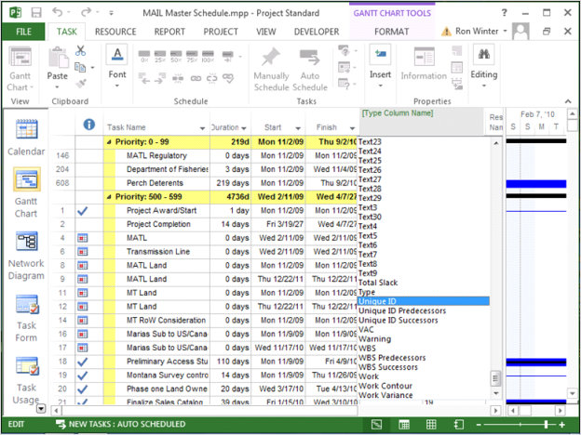
Creating OOS Report
Click on Unique ID
Internally assigned
Never changes

Slide 52
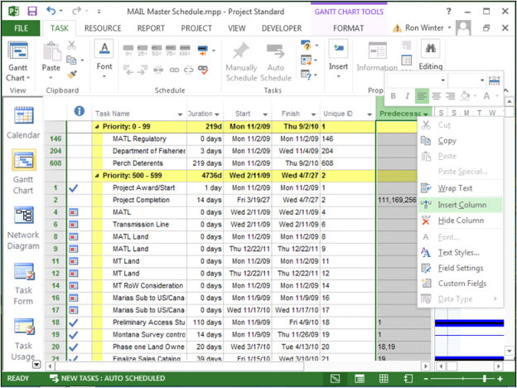
Creating OOS Report
Repeat
Right-click column header
Click on Insert Column

Slide 53
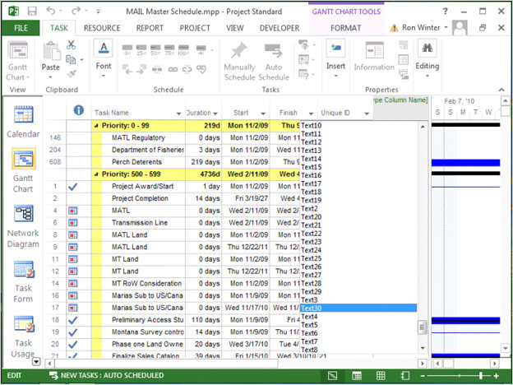
Creating OOS Report
Click on Text30
Last User- defined field
Use this for report output

Slide 54
2025 Construction CPM Conference Out-of-Sequence Report for Project

Slide 55
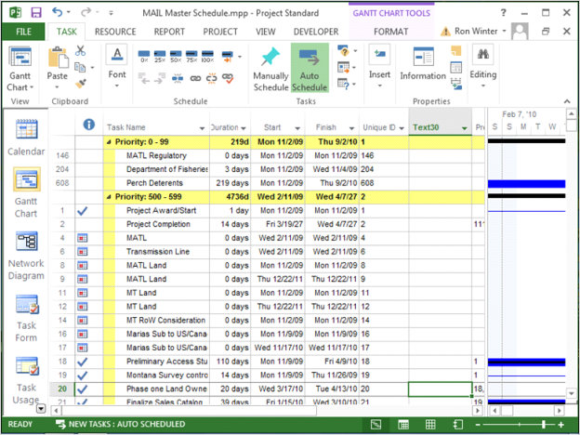
Running OOS Report
Run Out-of- Sequence Report
Click on Developer tab

Slide 56
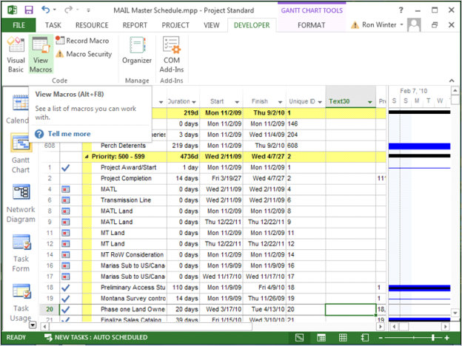
Running OOS Report
Click on View Macros button
Macros
Code
Scripts
Can add button

Slide 57
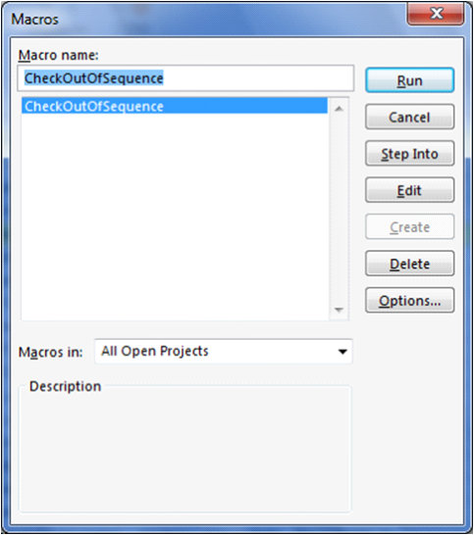
Running OOS Report
Select CheckOutOfSequence
Click on Run button

Slide 58
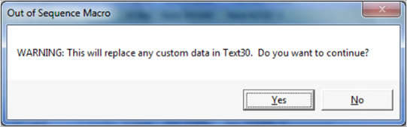
Running OOS Report
Last chance to ‘chicken-out’
Use in case the macro accidently was selected

Slide 59
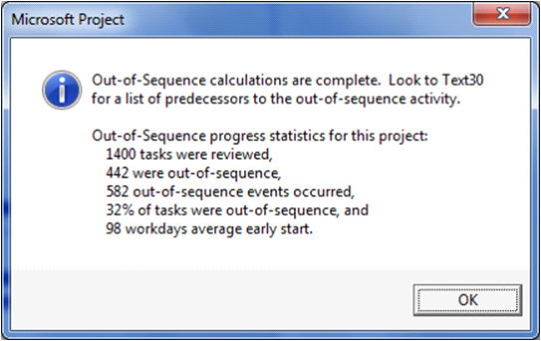
Running OOS Report
Report Calculations are complete
Statistics displayed
# Tasks started
# OOS acts
# OOS events
% tasks OOS
Average early start
Click OK button

Slide 60
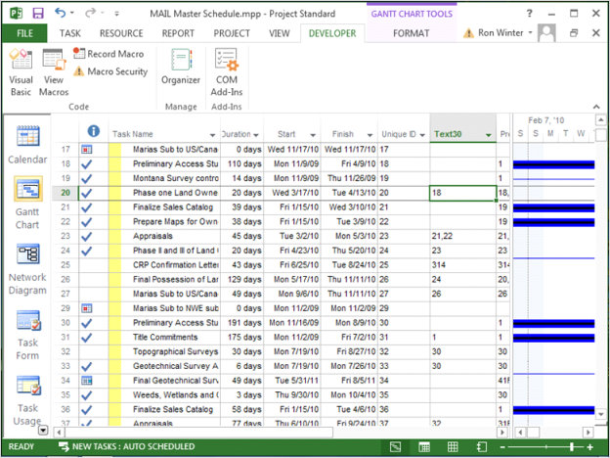
MS Project OOS Report
Text30
Unique ID
Predecessor Unique IDs
Shown left
UID #20 OOS
To UID #18
Blank = not OOS

Slide 61
2025 Construction CPM Conference Recap

Slide 62
Types of OOS
Direct Out-of-Sequence
Activity started before immediate predecessor finished
Indirect Out-of-Sequence
Activity started earlier than distant predecessor
Direct Out-of-Sequence
Indirect Out-of-Sequence

Slide 63
Types of OOS
Inactive Out-of-Sequence
Predecessor is complete
Active Out-of-Sequence
Predecessor has not completed as of the data date
This is what our New Technique reports
Inactive | Active

Slide 64
Types of OOS
Put this together
Most CPM software only report
Inactive Direct OOS
Active Direct OOS
Inactive Direct Out-of-Sequence | Active Direct Out-of-Sequence
Inactive Indirect Out-of-Sequence | Active Indirect Out-of-Sequence

Slide 65
Types of OOS
P6 Professional reports on this
Direct OOS, predecessor is incomplete
New P6 filter reports on this
Activity started
Early Start greater than Data Date
Inactive Direct Out-of-Sequence | Active Direct Out-of-Sequence
Inactive Indirect Out-of-Sequence | Active Indirect Out-of-Sequence

Slide 66
Types of OOS
No software reported on this
Indirect OOS and the predecessor is complete
Except Schedule Analyzer Forensic
Inactive Direct Out-of-Sequence | Active Direct Out-of-Sequence
Inactive Indirect Out-of-Sequence | Active Indirect Out-of-Sequence

Slide 67

2025 Construction CPM Conference
Questions?
Ron Winter, PSP, FAACE
Schedule Analyzer Software
ron@ronwinterconsulting.com

