Slide 1

2025 Construction CPM Conference (Really) Understanding Microsoft Project
Ron Winter, PSP, FAACE
Schedule Analyzer Software

Slide 2

Ron Winter, PSP, FAACE
Bachelor of Science in Engineering
Construction Scheduler
US Air Force Navigator
Construction Scheduler
Master of Science in Systems Management
Programmer, Project Manager, Customer Support, and Industrial Trainer
Construction Scheduler
Developer of Schedule Analyzer Software

Slide 3
Overview
This is not a ‘Features Presentation’
  Basic understanding of MS Project CPM
  How to update schedules
  How to simulate P6 Retained Progress
Microsoft Project = MSP

Slide 4
Introduction
Although Primavera products predominant
Many contracts specify Microsoft Project (MSP)
Advantages of MSP
Costs less
User-friendly
  Easy to start scheduling activities immediately
Decent default graphics and reports
Equipped on most US Federal Government PCs
  Hard to justify purchase of ‘second’ scheduling software

Slide 5
MSP Introduction
File based system
Linking schedules/documents is dangerous
  Uses direct DOS disk:path\file name references
  Imported schedules will not properly link or update
Work performed in memory with manual save
Post/Host/Publish model prevents simultaneous use
  One person at a time uses a schedule
    Even with MS Project Server
Best used in localized, small group installations

Slide 6
MSP History
DOS Versions
  V1 (1984), V2 (1985), V3 (1986), V4 (1986)
Windows Versions
  V1 (1990), V3 (1992), V4 (1993), V4.1 (1995),
  Project 98 (V9), Project 2000, Project 2002, Project 2003, Project 2007, Project 2010, Project 2013, Project 2016, 2019
MS Project Server Versions
  Project Central (2000), Project Server (2002),
  Office Project Server 2003, Office Project Server 2007, Project Server 2010, Project Server 2013, Project Server 2016, Project Server 2019

Slide 7
MSP History
Many features only available in newer versions
Affordable upgrades to earlier license holders
  WRONG! Only up to MS Project 2007
We recommend MSP 2007 or later
  This paper was first written using MSP 2003
  Updated using MSP 2007
  Later partially updated using MSP 2013 & 2016 & 2019

Slide 8
Purchasing MSP
MSP is not included in MS Office Suites
MSP version must match your MS Office version
Standalone available in two editions
  Standard
    Project 2019 ~ $650
    Project 2016 ~ $600
    Project 2013 ~ $600
  Professional
    Standard + team collaboration tools + connect to Microsoft Project Server
    Project 2019 ~ $925 & $50
    Project 2016 ~ $350 & $70
    Project 2013 ~ $600

Slide 9
Purchasing MSP
MSP Cloud version
  Project Online Essentials: $7 per user per month
  Project Online Professional: $30 per user per month
  Project Online Premium: $55 per user per month

Slide 10
Purchasing MSP
Boxed set with CD & manual is hard to find
Two download options
  PC Download
  PC Key Card (hard to find)
    Some resellers offer this option without telling you.
    Secret is if they are going to mail ‘the software’ to you.

Slide 11
Purchasing MSP
PC Download
  ‘Immediate’ use
  Buy from seller/download from Microsoft website
  Activate with key code emailed to you from seller
PC Key Card
  Intended for OEM manufacturers
  Normally less expensive option
  Actual physical card snail-mailed to you
  Download & activation instructions on the card
  Only available to USA addresses

Slide 12

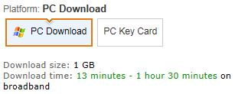
Purchasing MSP
Download confusing
  Pick the 32-bit or 64-bit version
    Setup.x64.en-US_ProjectStdRetail.exe = 64-bit
    Setup.x86.en-US_ProjectStdRetail.exe = 32-bit
  PC Download or PC Card?
    PC Download quickest but more expensive
    PC Key Card mailed to you (for 3rd-party resellers)
      You still have to download the software

Slide 13
Purchasing MSP
Download confusing
  First download a Download Manager
    Download Manager is a peer-to-peer software
    Stays resident and helps others download from you
  Background download continues
    User typically tries to run download before complete
  Finished download has no file extension
    I had to add, “.exe” to the end in order to run (browser issue)
  Installation smooth after this
  Uninstall Download Manager

Slide 14
Issues
Construction schedulers struggle with MSP
Contracts require periodic updates
  Assessment of the project status
  An integral part of project management
  Critical communication tool between the parties
MSP update process is confusing
  Limited baseline management
  Updating task status (% Complete)
  Data Date issues
  ‘Ease of use’ features
    Automatically inserts actual dates and remaining durations

Slide 15
2025 Construction CPM Conference MS Project Differences

Slide 16
MSP Differences
MS Project operates differently from
  Oracle/Primavera P6™ and P6 Professional™
  Oracle/Primavera Enterprise Project Portfolio Manager (EPPM)™
Understanding the differences helps to understand MSP

Slide 17
Differences from P6
Changes to database only saved when closed
  P6 changes saved when entered
Activities do not have an Original Duration
Non-fixed Activity IDs
  Problem for automated comparison
  Does have non-editable Unique ID field
MSP float called “Slack”
  “0” Slack for completed activities
One relationship between two activities
Has unique concepts
  Deadlines, Reoccurring Tasks

Slide 18
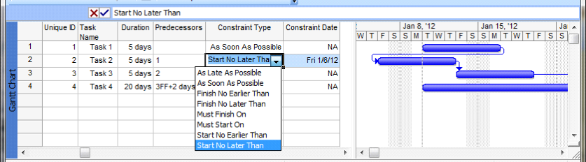

Differences from P6
All MSP activities have a constraint assigned
  Activities can only have one constraint
  ‘As Soon As Possible’ is the default
  ‘Start/Finish No Later Than’ overrides logic
  ‘As Late As Possible’ uses Total Float (not Free Float)
  Dragging activity bar creates FNLT constraint

Slide 19
MSP Summary Tasks
Inherit status data from their detail tasks
  Actual Start automatically assigned when summarized task given an actual start
  Actual Finish assigned when all tasks given actual dates
  Percent Complete = (Sum Actual) /
  (Sum At Completion)
  Problematic when exporting to P6
    Creates unnecessary duplicate WBS element
    Links to tasks cause errors when exporting
      Generated when tasks are indented

Slide 20
MSP Summary Tasks
Manual Update of Summary Tasks
  Manual updates ‘Push-Down Status’
  Not used in construction environments
  Affects all the detail tasks below it
Summary Tasks can be moved
  Changes tasks being summarized
Summary baseline dates unchanged when tasks adjusted
“Roll Up Baselines” resets baseline dates

Slide 21
Differences from P6
No ‘real’ milestone activities
  Display both Start & Finish Dates
  Zero-duration activities 'tagged' as milestones
  No calendar (scheduled immediately)
WBS can be blank
  This will generate an error importing to P6
Some scheduling terms different in MSP
  Multiple Critical Paths
  Baseline Schedules
  Summary Tasks

Slide 22
Differences from P6
Calculated Percent Complete
  P6: (Original Duration – Remaining Duration) / OD
  MSP: Actual Duration / (Actual + Remaining Duration)
    Why the difference?
    MS Project does not have an Original Duration!
MSP lacks basic CPM functionality
  No activity Original Duration
  No Longest Path
  Different internal calculations than P6

Slide 23
Calculation Differences
P6 | MSP
Calculation starts at Data Date | Calculation starts at Project Start
Early/Late Start/Finish dates computed for every activity in the schedule* | Actual dates are used for calculating next activities’ start or finish dates
Requires you to set a Status date | Does not require you to set a Status Date
* Except for P6 Actual Dates calculation mode

Slide 24
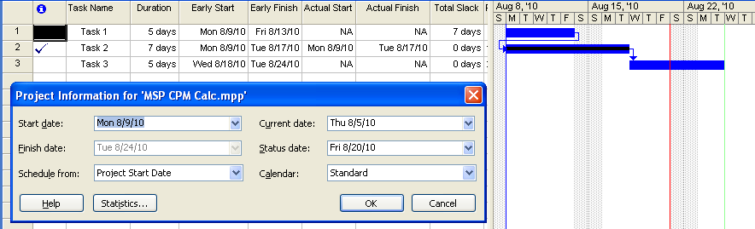
Status Date Ignored
  Task 1 not started in the ‘past’
  Task 2 complete
  Task 3 planned start in the ’past’
We can make MSP schedule dates similar to P6

Slide 25
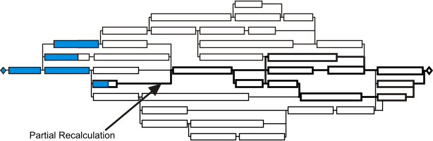
CPM Recalculation
MSP status updates only affect successor activities
  No ‘F9’ re-calculate entire schedule
  Partial re-calculation

Slide 26
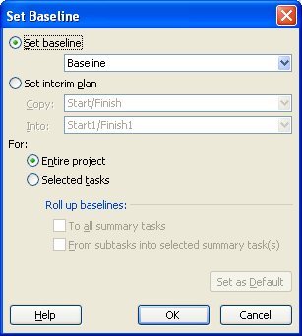
Baseline Schedules
When MSP creates a baseline schedule
  Early Start & Early Finish dates copied to
  Baseline Start & Finish Date fields
  Duration copied to Baseline Duration
  Task Costs & Work copied to
  Baseline Costs/Work fields
  Nothing else is saved
2 dates + 1 duration + 1 cost +
1 work-hour count
Tools / Tracking / Set Baseline*
MS Project menu navigation command
(printed in green) to reach that screen

Slide 27
Baseline Schedules
MSP Baseline a partial snapshot of the schedule
  Used for Earned Value calculations
  Does not store logic, float, or constraints
  Cannot recalculate any of the stored information
  Late Start and Late Finish dates are not stored
    All variance measurements assessed from the early dates
  Baseline fields can be edited by users

Slide 28
Baseline Schedules
Not sufficient for recreating a schedule
  Cannot convert back into a fully functional schedule
Not sufficient for a year’s worth of updates
    Allows for a maximum of 11 baselines
Interim Plan feature is like a Baseline
  Similar functionality as baselines
  Stores less information than a baseline
    Only Early Start and Early Finish dates of tasks

Slide 29
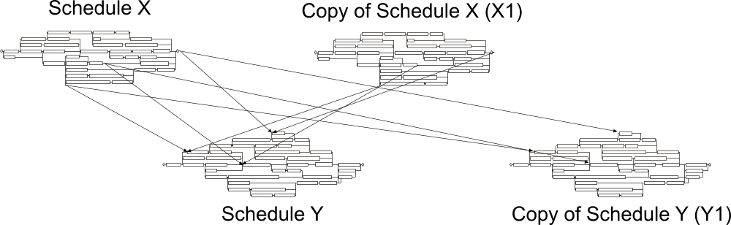
Baseline Schedules
Solution:
  Save the various versions of the entire file
  Rename MS Project file with the status date
    Remember that links are file-name specific

Slide 30
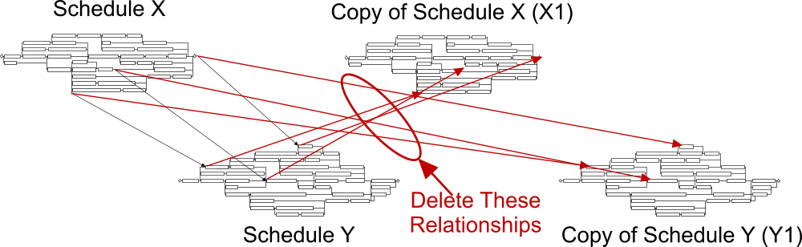
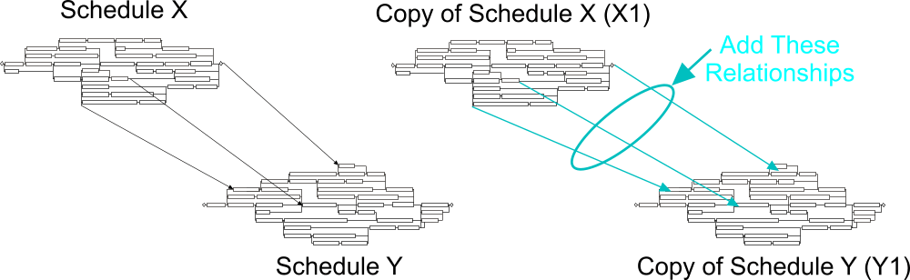
Baseline Schedules
You are going to need to ‘fix’ the relationships

Slide 31
MSP & P6 Exchanges
These are the tested configurations
  Microsoft Project 2002 - MPP, MPX
  Microsoft Project 2003 - MPP, MPX
  Microsoft Project 2007 through 2019 – XML
You need to prep the MSP import file
  No ‘empty’ MSP lines
  No logic to summary activities
  No blank WBS entries
  Lags might be based on a hourly calendar
  Embedded/linked MSP projects will not be imported

Slide 32
2025 Construction CPM Conference Tracking Progress

Slide 33
Tracking Progress
Properly tracking progress requires planning
Schedule Set-up
Setting a Baseline
Updating the schedule
Comparing schedule updates

Slide 34
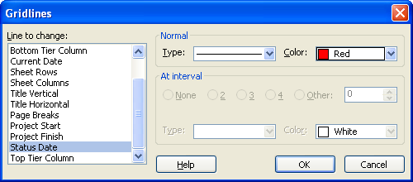
Schedule Set-up
Settings must be set before adding activities
  No manual general schedule recalculation
Proper display of status date
  Hide Current Date
    Computer date
  Show Status Date
    P6 Data Date
Format / Guidelines

Slide 35
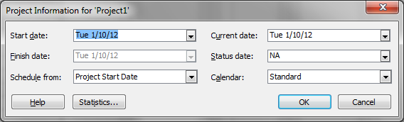
Schedule Set-up
Set the status date
  P6 Data Date
Project / Project Information

Slide 36
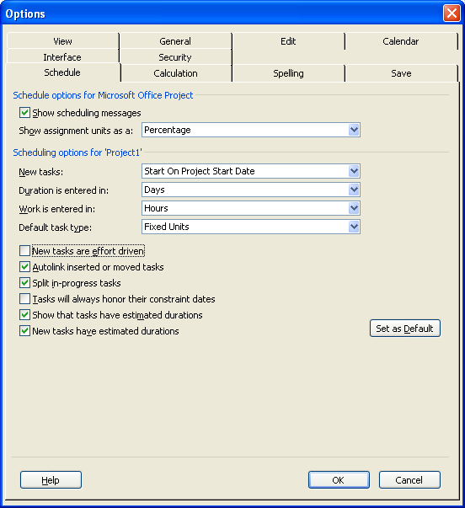
Schedule Options
Tools / Options / Schedule Tab
Default Task Type
  NOT Fixed Duration
New Tasks effort driven
  Unchecked
Autolink inserted
  Unchecked
Split in-progress tasks
  Checked
Always honor constraints
  Unchecked
Estimate Durations?

Slide 37
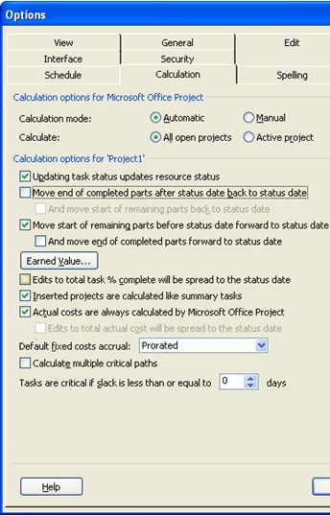
Calculation Options
Tools / Options / Calculation Tab
Updating task status
  Checked
Move end of completed
  Unchecked
And move end of complete
  N/A
Move start of remaining
  Checked
And move end of complete
  Unchecked
Calc multiple critical paths

Slide 38
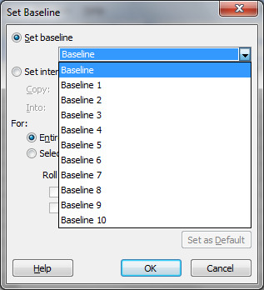
Setting a Baseline
MSP Baseline versus Baseline Schedule
  Baseline schedule dates stored internally
Needed to display comparison bars
Saves:
  Early Start date
  Early Finish date
  Duration
    Actual + Remaining Duration
  Activity cost
  Activity work
Also resets Summary Tasks
Tools / Tracking / Set Baseline

Slide 39
Updating the Schedule
Where P6 schedulers have problems
  Do not understand update components
Components are interlinked
  Duration (not Original Duration)
    Actual + Remaining Duration
  Actual Duration
    Duration x (1 - Percent Complete)
  Remaining Duration
    Duration – Actual Duration
  Percent Complete
    Actual Duration / Duration

Slide 40
Updating Rules
Key is what gets recalculated
% Complete & Remaining Duration always recalculated
Remember value that stays the same

Slide 41
Updating Rules
Add Actual Start
Change Remaining Duration
Add Actual Duration
Change Duration
OR
Add Percent Complete

Slide 42
Updating MSP
Assign Actual Dates first
Work with the system
  (Still) assess remaining duration
  Divide Remaining Duration by Duration
  Enter a % Complete
  Confirm all other fields are correct
Adjust Actual Duration & Remaining Duration
  If Actual Duration line not up to Status Date, adjust
  Re-enter Remaining Duration
  Do not worry about Duration number

Slide 43
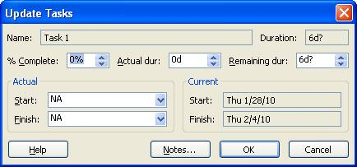
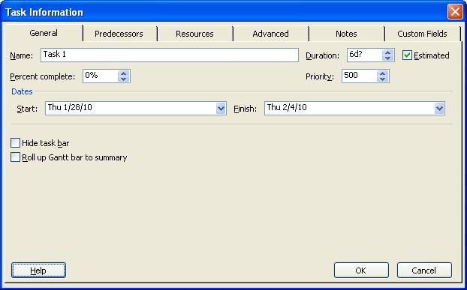
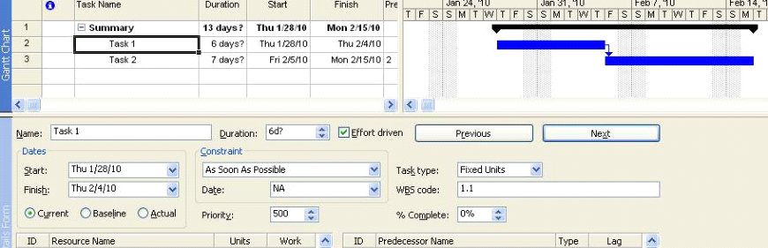
Update Methods
Update Tasks Form
  Closes after each activity
Task Information Form
  Closes after each activity
Task Details Form
  Closes after each activity

Slide 44
Update Methods
Tracking Table in the Gantt Chart
  Recommended for speed and accuracy
  Show all columns to spot accidental changes

Slide 45
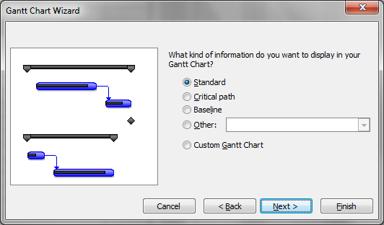
Analyze Progress
Identifying Variances
  Start Variance & Finish Variance columns can be used
  Can display baseline & schedule update in same view
  Gantt chart wizard
Format / Gantt Chart Wizard

Slide 46
Analyze Progress
MSP 2007 and later has a ‘Compare Project Versions’ utility
  Graphically compares tasks and resources
  Hard to understand
    Confusing
    Not very useable for presentations
MSP has a built-in VBA programming language
  Allows for development of custom comparison software
    Cannot prevent copying and altering

Slide 47
Analyze Progress
Exporting schedules to MS Access or Excel
  Use it to compare the two schedules
Third-party software comparison tools
  If it reads multiple CPM software, does one size fit all?
    MSP does not have an Original Duration field

Slide 48
2025 Construction CPM Conference The Correct CPM Setup

Slide 49

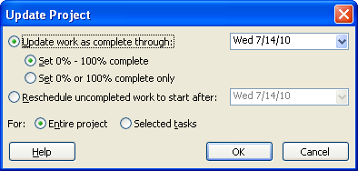
Process Overview
Not designed to calculate CPM using a Status Date
Set the Status Date
Force MSP to observe the Status Date
Change w/ Update Project
  Reschedule uncompleted
Project / Project Information
Tools / Options / Calculation options
Tools / Tracking / Update Project

Slide 50
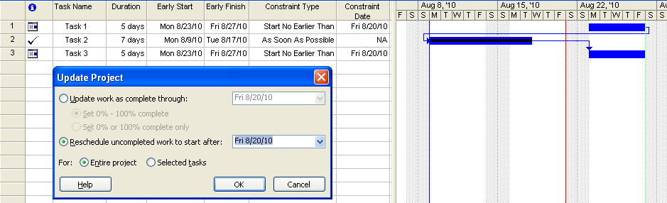
Process Overview
Unstarted tasks
  Start No Earlier Than constraint = Project Status date
In-progress tasks
  Resume Date set to the Update Project date
Tasks lose any existing constraints

Slide 51
Disadvantages
One constraint per task – existing deleted
In-progress tasks resume date set to update project date
Only one out-of-sequence calculation mode
Problems later if destatusing the project
Update Project feature does not update the graphical Status Date setting
Can still have tasks in future with actual dates
  Same as P6 except,
  No automatic notice in CPM computations report

Slide 52
Disadvantages
Does not change the start of CPM calculations
  Still Project Start
These are not true CPM Calculation Modes
  “Constraint-Based CPM Calculation Mode”

Slide 53
CPM Checklist
Split In-Progress Tasks option must be selected
Must select desired options before tasks added
Updating task status updates resource status option must be checked
Task duration type must not be “Fixed Duration”
  Opposite of normal P6 setting
Tasks only reflect the CPM options if updated by
  Percent Complete (MS 2003)
  Percent Complete or Remaining Duration (MS 2007+)

Slide 54
2025 Construction CPM Conference Putting It All Together

Slide 55
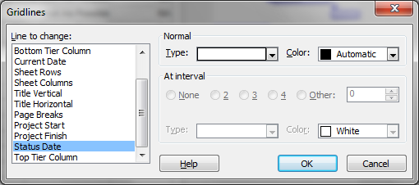
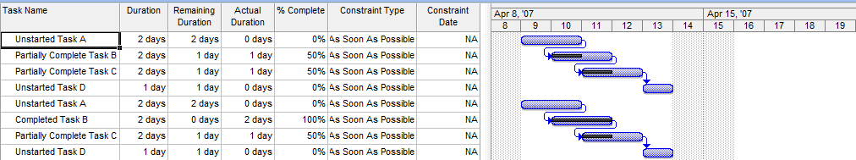
Before Set-Up
Project / Project Information
Format / Guidelines

Slide 56
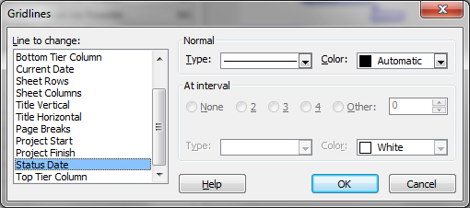
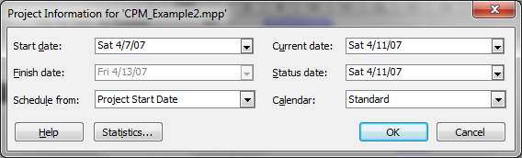
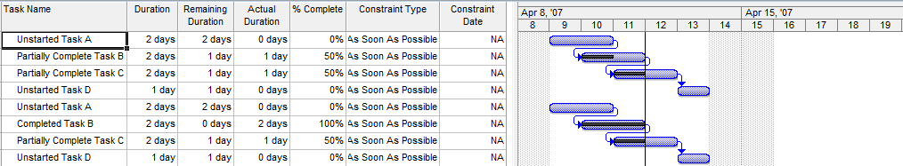
After Setting Status Date
Project / Project Information
Format / Guidelines
56

Slide 57
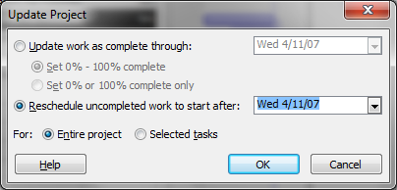
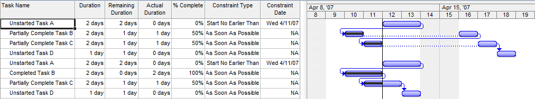
Reschedule Work
Tools / Tracking / Update Project
‘Progress Override’
‘Retained Logic’
57

Slide 58
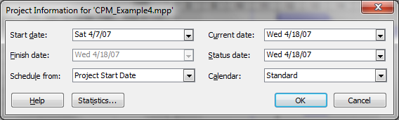
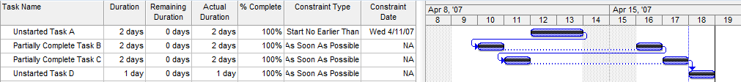
After Final Update
Project / Project Information
Notice that Actual Duration is incorrect

Slide 59
2025 Construction CPM Conference Conclusions

Slide 60
Conclusions
MS Project is easy to set-up a schedule
Baseline functionality is poor
Updating typically causes unintended changes
Built-in update help routines may corrupt status
  Automatic insertion of made-up dates and durations
Data Date issues complicate update process
Hard to note uncompleted work in the past
Difficult to identify variances
Impossible to accurately remove status
  Time Impact Analysis / What-If Schedules

Slide 61
Assessment of MSP
Microsoft Project can be properly used in construction
  Easy to build a schedule
  More difficult to status accurately
    User-assist features can change actual data
  Very difficult to monitor status
    Easy to have un-finished work in the ‘past’
  Forensic analysis depends on saved backups
    Baseline feature not capable of rebuilding activity
Recommend version MS Project 2007 or later

Slide 62

2025 Construction CPM Conference
Questions?
Ron Winter, PSP, FAACE
Schedule Analyzer Software
ron@ronwinterconsulting.com

