Slide 1
Comparing GAO and DCMA Schedule Assessments
Presentation to the Construction CPM Conference, January 2026
Jason T Lee Assistant Director Science, Technology Assessment, and Analytics U.S. GAO | James Buckingham Cost and Pricing Command (CPC) – EVMS Group (DCMAP-E) Defense Contract Management Agency

Slide 2
Presentation Overview
Introduction and purpose
Overview of GAO and GAO’s schedule assessment process
Overview of DCMA and DCMA’s schedule assessment process
GAO’s updated schedule assessment instructions and procedures

Slide 3
Introduction
DCMA and GAO schedule health metrics are often compared against each other, usually out of context
A direct comparison of metrics often ignores the purpose and scope of our assessments
Our schedule health metrics are fundamentally the same, but a direct comparison is difficult
We are in the process of codifying and documenting our schedule assessment procedures

Slide 4

About GAO
The U.S. Government Accountability Office (GAO) is an independent, nonpartisan agency that works for Congress.
Often called the "congressional watchdog," GAO examines how taxpayer dollars are spent and provides Congress and federal agencies with objective, reliable information to help the government save money and work more efficiently.

Slide 5
Purpose of a GAO Schedule Assessment
Determine the reliability of an IMS and the extent to which it is comprehensive, well-constructed, credible, and controlled using criteria published in GAO’s Schedule Assessment Guide (GAO-16-89G)
Schedule assessments are typically one of multiple objectives of a performance audit.

Slide 6
Scope of a GAO Schedule Assessment
Two-part assessment covering ten best practices
Extensive schedule health analysis (50+ metrics)
Interviews with agency and program office officials on the creation, maintenance and use of the schedule (60+ questions)
If the schedule is deemed unreliable, GAO typically makes a Recommendation for Executive Action to the agency to address issues identified in the assessment

Slide 7
DCMA Overview and Schedule Assessment Process
James Buckingham
Cost and Pricing Command (CPC) - EVMS Group (DCMAP-E)
January 20, 2026

Slide 8
Talking Points
DCMA EVMS Group Mission and Organization
CPC Organizational Structure
CPC Vision, Mission and Commitment
EVMS Group Organizational Structure
EVMS Group Mission and Vision
DCMA EVMS Group Assessment Procedures
EVMS Group Business Practices
DCMA EVMS Test Metric Specifications
DCMA Generated Critical Path
EVMS Group CAR Trends
EVMS Open CARs
Most Common EVMS Deficiencies
CAR Database - What We’re Seeing
Contact and Further Information
20260107/DCMA Overview and Schedule Assessment Process/CPC

Slide 9
DCMA EVMS Group Mission and Organization
20260107/DCMA EVMS Group Mission and Organization/CPC

Slide 10
DCMA Cost and Pricing Command
B Group (DCMAP-B)
Tools and Analysis
03047357 DIRECTOR SHANI MACK
03049968 | EXEC DIR, COST & PRICING |  |  |  |  | JORGE BENNETT
03047318 | DEP REGIONAL COMMANDER |  |  |  |  | MARY SHERIDAN
03047352 | EXECUTIVE ASST |  |  |  |  | LESLIE THIELBAR
D Command Group (DCMAP-D)
A Division (DCMAP-A)
Pricing Division
03047322 DIRECTOR MARK JONES
C Group (DCMAP-C)
Commercial Item Group
03138079 DIRECTOR DANIEL HAWLEY
E Group (DCMAP-E)
Earned Value Management Systems Group
03050026 DIRECTOR DONNA HOLDEN
F Group (DCMAP-F)
Mission Support Group
03145980 DIRECTOR BRENDA GOODRICH
H Division (DCMAP-H)
CACO/DACO Division
03047364 DIRECTOR GEORGE (TABE) MEDILL
I Group (DCMAP-I)
Specialty Pricing Group
03047418 DIRECTOR ROBERT CORSO
20240728/Org Charts v1/CPC

Slide 11
CPC Vision, Mission and Commitment Statements
Cost and Pricing Command (CPC)
Vision | A team of trusted professionals delivering value to our Warfighters throughout the acquisition lifecycle.
Mission |Deliver superior cost and pricing insight supporting affordability and readiness for the DoD and its partners.
Commitment | Improve Internal/External Customer Engagement/Focus and Deliver Value to the Department of Defense.
20260107/CPC Vision, Mission, and Commitment Statements/CPC

Slide 12
Earned Value Management Systems Group
Director: Donna Holden
donna.g.holden2.civ@mail.mil (703) 819-4264
P-E EVMS Group
Operations Supervisor: Erik Berg
erik.s.berg.civ@mail.mil (952) 259-5496
EA
Mr. John Ricci
john.e.ricci.civ@mail.mil 469.610.6350
- Boeing - Fincantieri - DSS - L3H / AR
- APTIM - Sevenson - GE - Spirit - CACI
ED
Mr. Andrew Hayden
andrew.d.hayden4.civ@mail.mil 612.801.6916
- Lockheed Martin - Rolls Royce - JHU/APL
- Oceaneering
EB
Ms. Patty Gonzalez
patricia.a.gonzalez.civ@mail.mil 210.797.3497
- BAE - Bechtel - Irving Shipbuilding
- GD - Battelle - Draper
- General Atomics - Textron Systems - Eastern Shipbuilding - Sierra Nevada - CAE - Long Wave Inc.
Accenture - Honeywell
EF
Ms. Danielle Bemis
danielle.a.bemis.civ@mail.mil 520.301.8385
- Raytheon (Pratt/Collins) - Kratos - Iridium
- MOOG - Viasat
EC
Mr. Jean Christian Brutus
jeanchristian.brutus2.civ@mail.mil 612.801.7028
Northrop Grumman - GD BIW
Leidos - Amentum Services, Inc.
20251001/Org Charts v1/CPC

Slide 13
EVMS Group Mission & Vision Statements
EVMS Group
Mission |The EVMS Group contributes to the DoD acquisition process through actionable assessments of contractor effectiveness at supplier facilities, which provides stakeholders with expectations of future performance and potential impacts on individual contractors and/or programs.
Vision | Enable reliable EVMS data and perform independent analytics with maximum efficiency. Be an adaptable, technologically sound, and highly respected team of trusted individuals.
20260107/DCMA EVMS Group Mission & Vision Statements/CPC

Slide 14
DCMA EVMS Group Assessment Procedures
20260107/DCMA EVMS Group Assessment Procedures/CPC

Slide 15
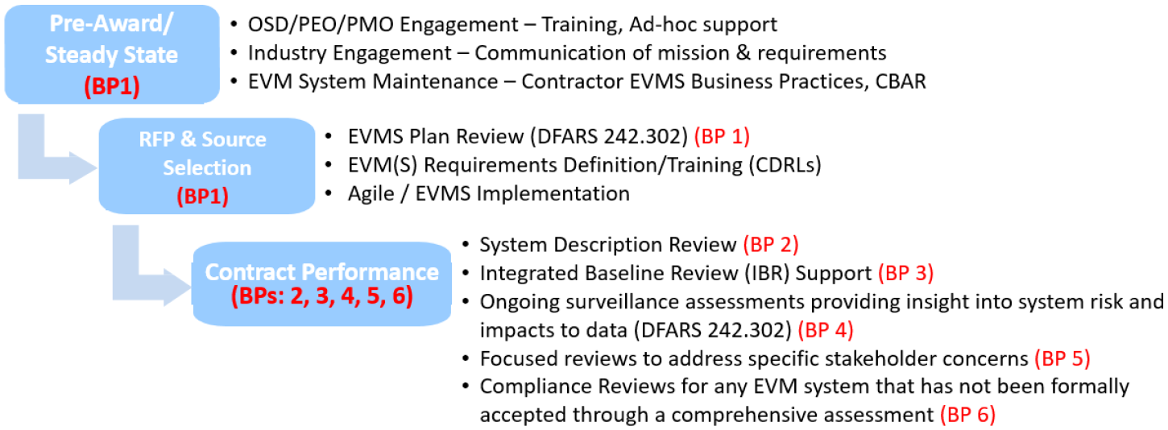
EVMS Group Assessment Procedures: Business Practices
The EVMS Group defines execution of our EVMS Defense Federal Acquisition Regulation Supplement (DFARS) mission through Business Practices (BPs)
20260107/DCMA EVMS Group Assessment Procedures/DCMA EVMS Website

Slide 16
EVMS Group Assessment Procedures: DECMs and Analysis
The DCMA EVMS Compliance Metrics (DECMs) are publicly available here: https://www.dcma.mil/HQ/EVMS/
As part of BPs, DECMs are used to assess non-compliance risk, 24 specific to schedule assessments (guidelines 6 and 7)
DECMs are revised through a Configuration Control Board (CCB), with one recently completed in August 2025. Revision 8.0 was released in October 2025 along with the new DECM Tiered Prioritization.
Proposed changes to DECMs can be submitted through redlined Word documents sent to the EVMS Group Inbox (link on the public site above)
The DCMA EVMS Group also performs independent analysis when assessing schedules, such as generating a DCMA Critical Path and Schedule Risk Assessment
20260107/DCMA EVMS Group Assessment Procedures/DCMA EVMS Website

Slide 17
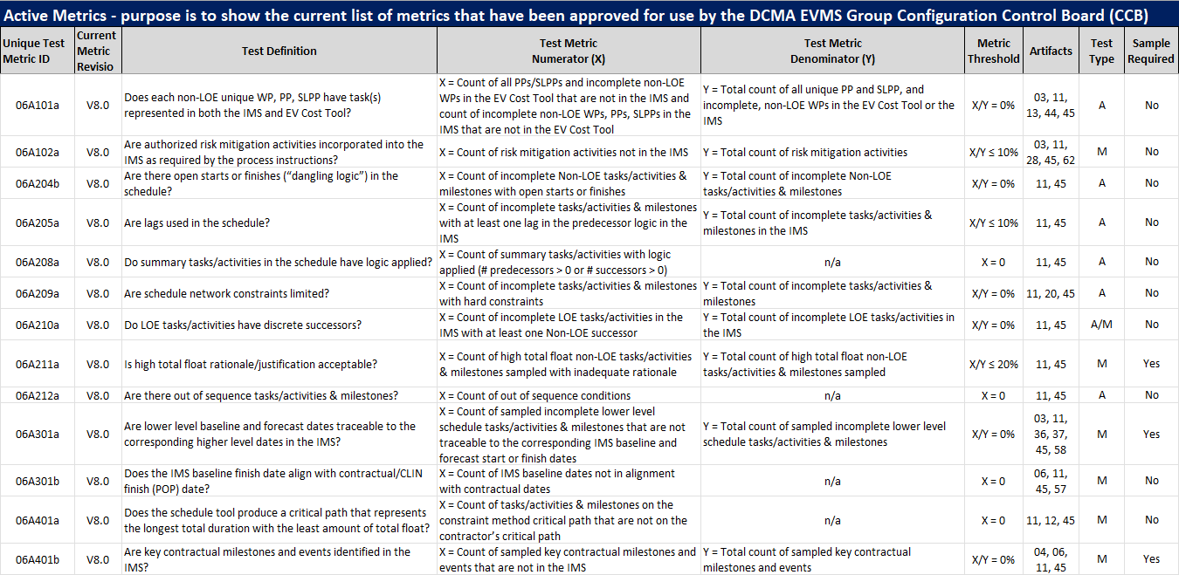
EVMS Group Assessment Procedures: DECMs
20260107/DCMA EVMS Group Assessment Procedures/DCMA EVMS Website

Slide 18
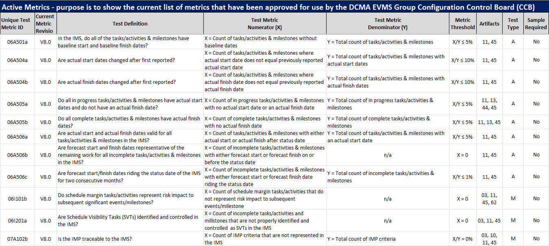
EVMS Group Assessment Procedures: DECMs
20260107/DCMA EVMS Group Assessment Procedures/DCMA EVMS Website

Slide 19
EVMS Group Assessment Procedures: Critical Path
DCMA Constraint Method using Microsoft Project:
Filter out all completed and summary tasks/subproject line items; get to lowest level tasks where logic exists.
Remove all hard constraints (Must Start On, Must Finish On, Start No Later Than, Finish No Later Than). Judiciously choose what makes sense on your program.
Remove deadlines (MSP only) on tasks that have not started by inserting the “Deadline” column in MS Project and deleting any dates that may exist.
Constrain the program completion milestone (i.e. “Contract End”) to finish no later than several months (use a minimum of six months) prior to the baseline finish date.
Recalculate the schedule (F9).
Sort the Total Float column in ascending order. Expect to see large negative float (i.e.: -183 days)
Code the tasks with the least amount of total float using text field (User ID), named “CP”.
Remove the constraint applied in step 4 on the final milestone or discrete task and recalculate the schedule (press F9 key).
Filter for the critical path code that was created in the text field (User ID) column in step 7 named “CP”.
20260107/DCMA EVMS Group Assessment Procedures/DCMA EVMS Processes

Slide 20
DCMA EVMS Group CAR Trends
20260107/DCMA EVMS Group CAR Trends/CPC

Slide 21
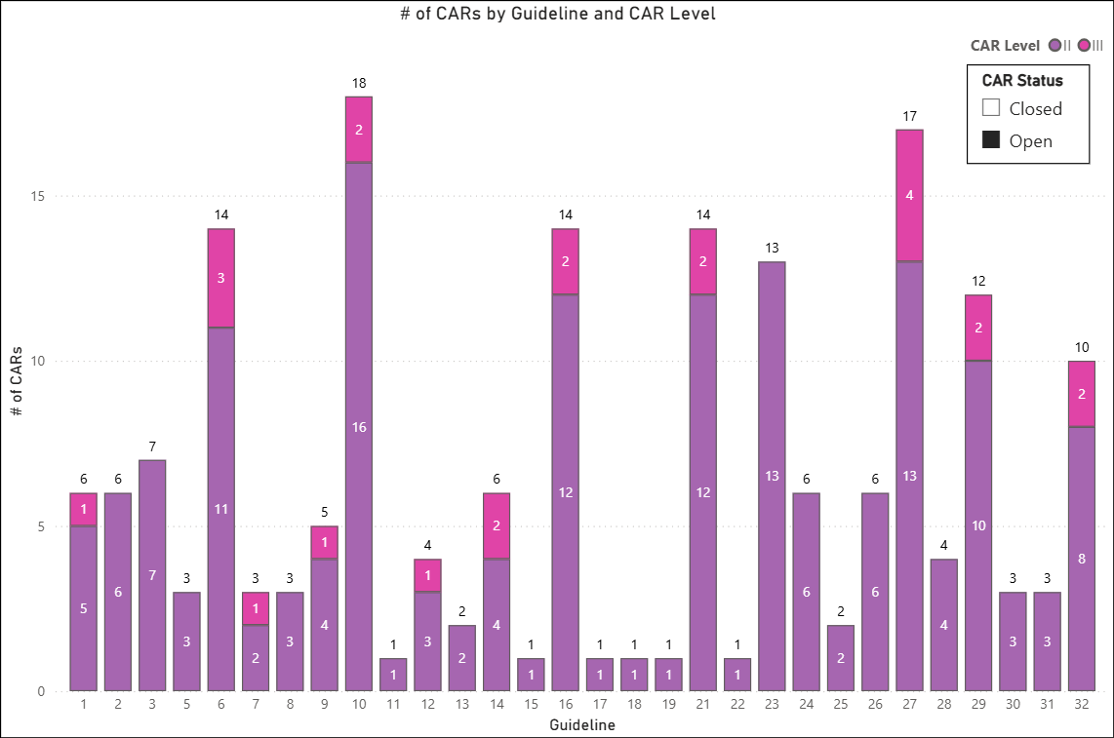
EVMS Open CARs
DCMA CAR database (PDREP*) from October 2019 – December 2025
167 open EVMS CARs
GL 6 has some of the most open CARs and represents 8% of all EVMS CARs
*Product Data Reporting and Evaluation Program, operated by US Navy and adopted by DCMA in 2018; PDREP Secretary of the Navy Instruction 4855.3 PDF (SECNAVINST 4855.3D PDF) Navy Standard Operating Procedure 3683 PDF (NAVSO P–3683 PDF)
20251222/DCMA EVMS Open CARs/PDREP

Slide 22
Most Common EVMS Deficiencies
GL 6: Schedule integrity
GL 10: Objective criteria and Quantifiable Backup Data (QBD) traceability
GL 16: Consistency of performance and actuals
GL 21: Consistency of performance and actuals on material and material accountability
GL 23: Control Account (CA) Variance Analysis Reports (VARs) pursuant to requirements in the Earned Value Management System Interpretation Guide (EVMSIG)
GL 27: Monthly ETC, Comprehensive EAC (CEAC) traceability, and ETC cost (time-phasing) and schedule (forecast dates) integration
GL 29: Reconciling baseline changes
GL 32: Undocumented PMB changes
20251222/DCMA EVMS Open CARs/PDREP

Slide 23
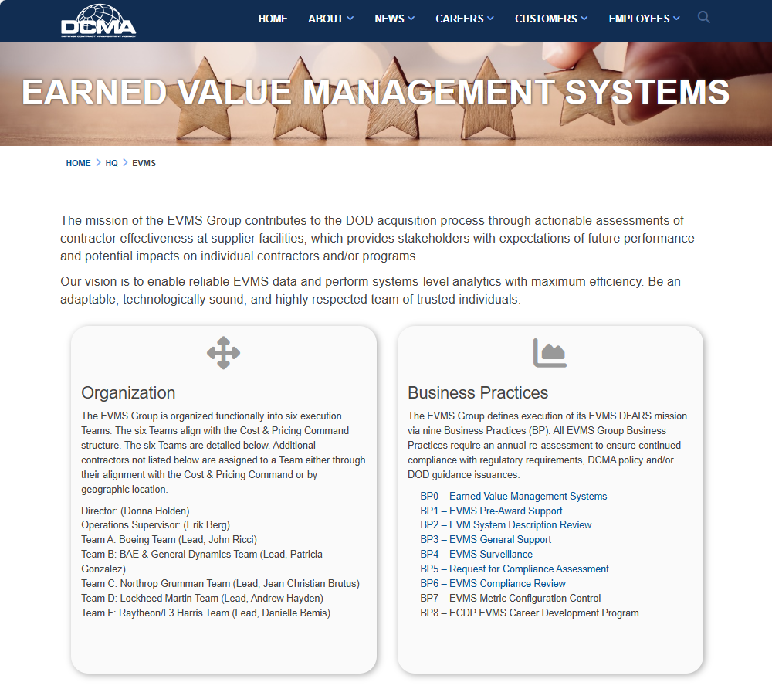
Contact and Further Information
Public DCMA EVMS Group Site: https://www.dcma.mil/HQ/EVMS/
Contact DCMA EVMS Group: dcma.gregg-adams.candp-cmd.mbx.dcma-evms-group@mail.mil
20260107/DCMA EVMS Group Contact Information / DCMA EVMS Website

Slide 24
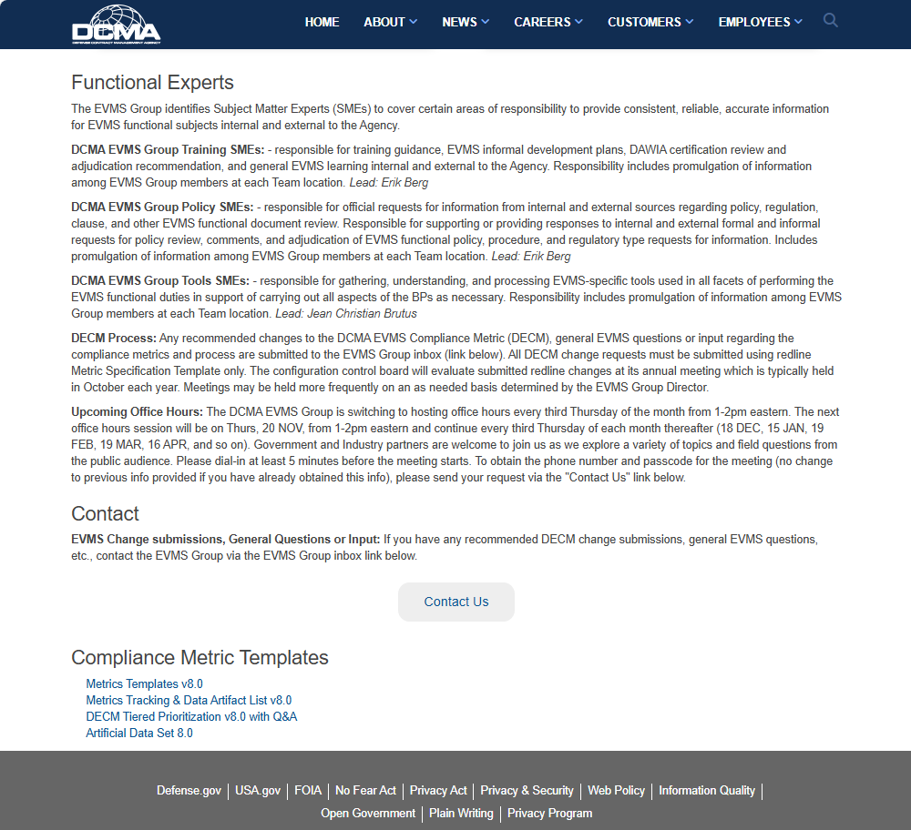
Contact and Further Information
Public DCMA EVMS Group Site: https://www.dcma.mil/HQ/EVMS/
Contact DCMA EVMS Group: dcma.gregg-adams.candp-cmd.mbx.dcma-evms-group@mail.mil
20260107/DCMA EVMS Group Contact Information / DCMA EVMS Website

Slide 25
GAO Schedule Assessment Procedures

Slide 26
ePM and Schedule Springboards
Engagement Project Management (ePM) is a set of tools, techniques, and guidance built by GAO to improve project monitoring and reporting.
Scope Springboards are a set of tools that GAO teams can use to facilitate collaborative conversations with their stakeholders about which methodologies to use, the benefits and drawbacks of different methodologies, and the extent of work tasks that may be involved in each.

Slide 27
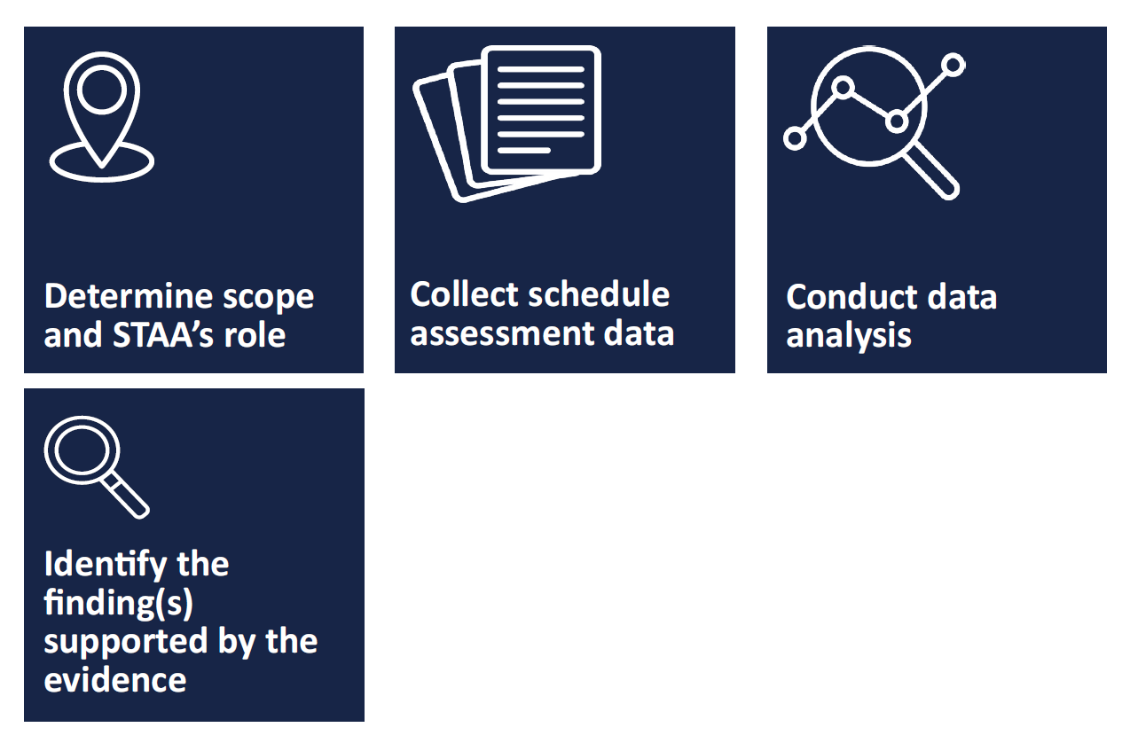
ePM and Schedule Springboards
Each Scope Springboard displays the high-level categories involved with planning, conducting, and finalizing each methodology and illustrates the work tasks involved.
The Schedule Scope Springboard displays the main lines of work involved in the schedule assessment methodology and illustrates work tasks using a work breakdown structure.

Slide 28
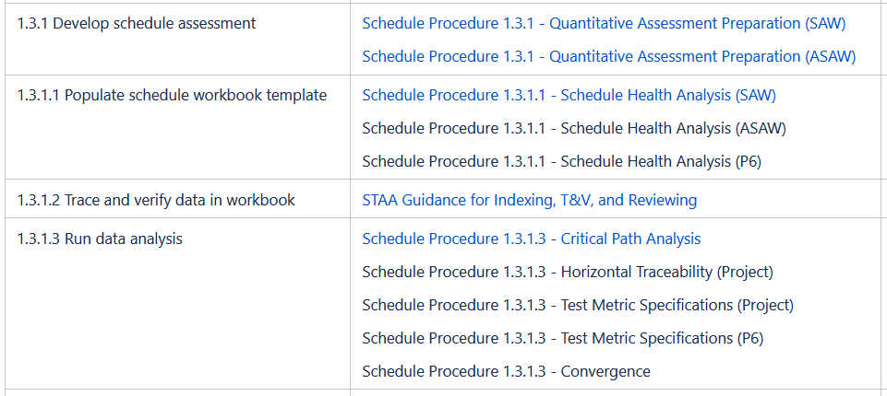
Schedule Assessment Procedures
GAO has created multiple process documents to formally codify our approach to schedule reliability assessments. These are mapped to elements of the Schedule Scope Springboard.

Slide 29
Standardized Schedule Assessment Artifacts
Artifact | Description
Quantitative Assessment Preparation | Instructions for preparing Project, P6, and Excel for analysis
Schedule Health Analysis | Instructions for conducting quantitative schedule analysis
Critical Path Analysis | Procedure for assessing critical and longest paths
Horizontal Traceability | Procedure for assessing horizontal traceability
Test Metric Specifications | Definitions for schedule metrics
Convergence | Procedure for assessing convergence in a schedule
Record of Analysis | Standardized template for developing reliability assessments
Data Collection Instrument | Standardized list of documents collected from a program
Standard Interview Questions | Standardized list of questions asked of program officials during interviews
Schedule Analysis Workbook (SAW) | Standardized Excel workbook for creating schedule health metrics

Slide 30
Questions?

Slide 31
Thank you!
James Buckingham
james.w.buckingham3.civ@mail.mil
EVMS Specialist
Earned Value Management System Group (DCMAP-EA)
Cost and Pricing Command
Defense Contract Management Agency
Jason T Lee
leejt1@gao.gov
Assistant Director
U.S. Government Accountability Office
Science, Technology Assessment, and Analytics
Copyright
This is a work of the U.S. government and is not subject to copyright protection in the United States. The published product may be reproduced and distributed in its entirety without further permission from GAO. However, because this work may contain copyrighted images or other material, permission from the copyright holder may be necessary if you wish to reproduce this material separately.

